Slide 1

iOWA nATIONAL gUARD tRADITIONAL rETIREMENT sEMINAR
Time | Subject | Presenter
0800—0830 | Registration | SSG Schroeder
0830—0845 | Welcome | BG Kappelmann
0845— 0915 | DA Form 5016/NOE/Requesting Records | SSG Schroeder
0915—0945 | RCSBP | Lyndsay Thrane
0945—1000 | 20-Year Ring Request | SGT Miller
1000— 1015 | Break
1015—1030 | Requesting Retirement | SFC Cross
1030—1045 | TSP
1045—1100 | SSLI | Clare Moeller
1100—1110 | GESAC | Jeffrey Erickson
1110—1130 | HSS | CW3 Brian
1130—1200 | VA | Gavin Sandvig
1200—1300 | Lunch
1300—1330 | Education | Megan Cowman
1330—1400 | DEERS | SSG Dixon
1400—1415 | Break
1415—1515 | TRICARE | TBD
1515—1545 | RSO | Lyndsay Thrane
1545—1600 | Funeral Honors
1600—1630 | Closing Remarks/Travel Voucher | SSG Schroeder
*Times are tentative as some briefers may be shorter or longer than the allocated time. Lunch is on the economy

Slide 2
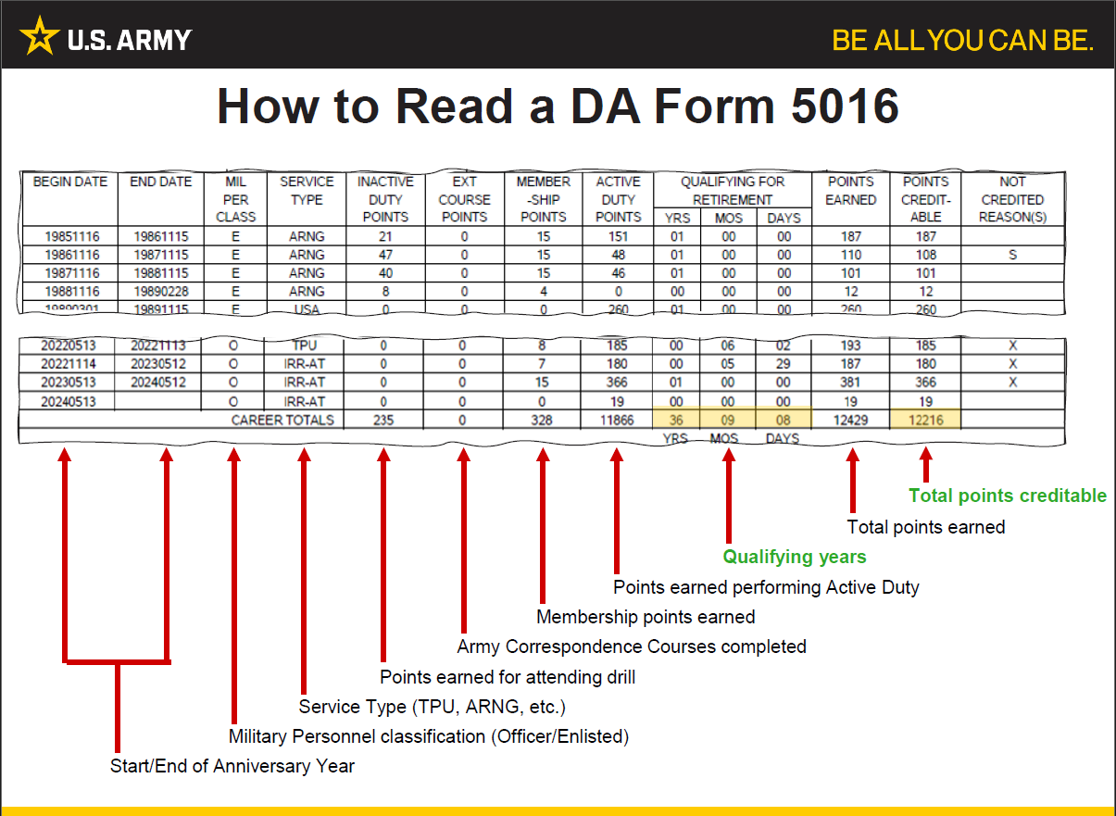

Slide 3
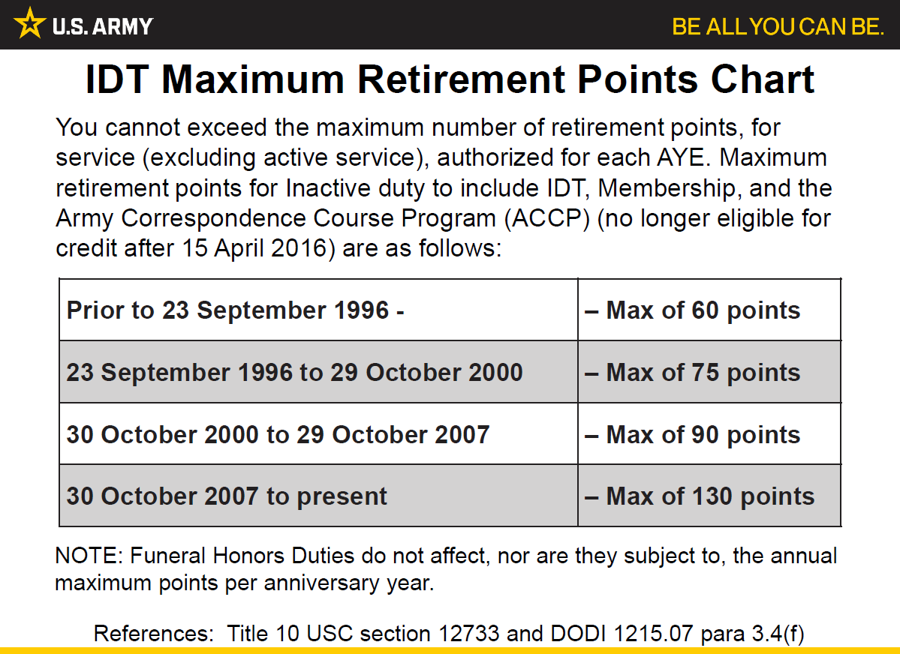

Slide 4
20-Year Letter/Notice of Eligibility
20-year letters are issued when a Soldier attains 20 qualifying years of service​, a qualifying year is a complete year in which the Soldier earns 50 or more points.
20-year letters are produced around the 15th of each month,​ they are generated for the previous month (i.e., if you attain 20 years of service in January, your letter will be generated in February).
NOE’s are now generated in IPPS-A. The Soldier who is receiving the NOE, and their S1 Pools receive a notification via e-mail that contains the 20-year letter, a DD Form 2656-5 (Reserve Component Survivor Benefit Plan (RCSBP) Election Certificate), RCSBP Fact Sheet, and a RCSBP Counseling Statement. The 20-year letter is then automatically sent to the Soldier’s iPERMS record.
Deployed service members will receive their NOE upon REFRAD​.
If a Soldier plans to retire immediately when they reach 20 years of service - the unit can request a Creditable Service Memorandum to be included in the retirement packet, in lieu of the 20-year letter.

Slide 5
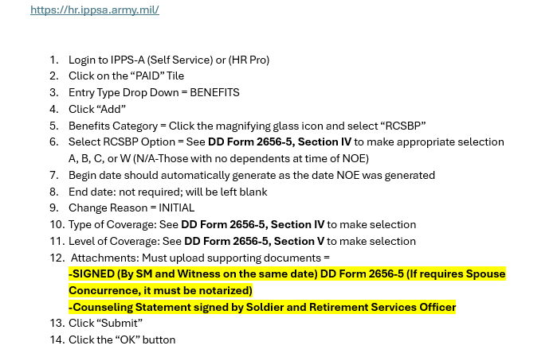
RCSBP Elections in IPPS-A

Slide 6
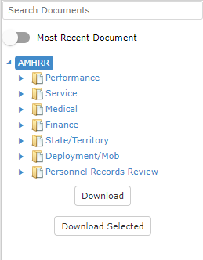
Records Request
Download your iPERMS Record *While still in uniform
  1. Log into iPERMS (https://iperms-ia.hrc.army.mil/)
  2. Click the “Documents” tab in upper left-hand corner
  3. Click “Download” on the lower left-hand side
To request records: Must fill out a SF 180.
Email: ng.ia.iaarng.mbx.retirement-servies@army.mil
Phone: (515) 252-4380 or (515) 252-4671

Slide 7
Reserve Component Survivor Benefit Plan (RCSBP)
Mandatory Brief
30 April 2024

Slide 8
Our Goal
Provide you with the facts so you can make an informed decision
Correct misinformation
Notes:
Our goal in this briefing is to provide information to you on the Reserve Component Survivor Benefit Plan, or RCSBP. Along the way, we expect to replace some common misconceptions about the Plan with facts.
We ask only that you unlock your assumptions and listen openly to this presentation.
Your decision regarding whether to participate in RCSBP/SBP affects your family’s future, and so, rather than making the decision based on someone else’s opinion, we encourage you to consider your situation.
Use what you learn in this briefing to make an informed decision that suits your family’s need. It’s a decision you will have to live with!

Slide 9
Purpose
Break RCSBP down into manageable, understandable blocks, to help you to make an informed decision on your individual RCSBP election
Allow RC Soldiers to make informed decision on their individual RCSBP elections

Slide 10

The Bottom Line
If the RC Soldier dies prior to receipt of retired pay the retired pay NEVER pays out.
Notes:
While many of you will see this statement as a blinding flash of the obvious -- believe it or not, there are Reserve Component Soldiers and spouses who don’t know this to be the case - who still believe that retired pay will go to the spouse if the RC Soldier dies before reaching age of eligibility for retired pay. That’s a myth! The fact is that entitlement to retired pay resides with and dies with the Retired Soldier and if they never reach the age of eligibility, retired pay never gets paid out!
RCSBP/SBP participation is the ONLY way to continue a portion of retired pay to a survivor.
The Army’s pledge to “take care of its own” is met by offering Soldiers a way to take care of THEIR own, through RCSBP/SBP.

Slide 11
Which risk are you willing to take?
NO RCSBP
Risk of leaving your loved ones with insufficient income
RCSBP
Cost vs Return
What if I don’t die before non-regular retirement?

Slide 12
What is RCSBP?
Enacted by Congress in 1978
Sole means for an RC Soldier with 20 years of qualifying service for non-regular retirement to provide a portion of their retired pay to survivors if they die before non-regular retirement
RCSBP and SBP are paid as a monthly annuity to eligible survivors
RCSBP decision affects SBP coverage at retirement
Certain elections constitute an early SBP decision
If retired from active duty, there is no RCSBP cost for coverage received

Slide 13
The Annuity
Annuity of 55% of selected base amount minus the RCSBP premium
RCSBP premium rate reduces to 0.0001 of the base when subtracted from the annuity
Paid until annuitant becomes ineligible or dies

Slide 14
Notification of Eligibility (NOE) for Non- Regular Retirement
Commonly referred to as the 20-Year Letter
Issued to RC Soldier upon earning 20 qualifying years of service (qualifying year = 50 or more points earned)
Contains a DD Form 2656-5 Reserve Component Survivor Benefit Plan (RCSBP) Election Certificate
15-Year Letter
  issued by ARNG only after Medical Board, ARNG Soldier asks for transfer to Retired Reserve, CG authorizes and publishes order
  USAR requires HRC final approval and issue of the 15-Year Letter

Slide 15
About Elections
Must be made within 90 days of receipt of Notification of Eligibility (NOE) for Retired Pay (20- Year Letter) packet from the Human Resource Command for USAR or State Headquarters for National Guard
Certain elections need spouse concurrence
Certain elections affect your SBP election
Certain elections require payment of RCSBP premiums when in receipt of retired pay for non-regular retirement

Slide 16
Three Part Decision
Election Option
Election Category
Base Amount
Notes:
An RC Soldier will need to decide on three components of RCSBP and complete the DD Form 2656-5 within 90 days or receiving their NOE.
Election Option
Election Category
Base Amount

Slide 17
RCSBP/SBP Timeline
RCSBP Coverage
SBP Coverage
NOE
Non-regular Retirement
RCSBP election affect on SBP
No RCSBP Coverage
Option A
SBP Election
Option B
Becomes SBP
Option C
Becomes SBP
Annuity payout
Death of Soldier
Option A
No RCSBP Annuity
Option B
A
A
= Annuity Starts
A
Option C
Premiums
Start
$
RCSBP Premiums
$
SBP Premiums
NOE
Non-regular Retirement

Slide 18
RCSBP Election Options
Option A: Decline RCSBP with option to elect SBP coverage at non-regular retirement
Option B: RCSBP coverage with deferred annuity when the RC Soldier would turn age 60
Option C: RCSBP coverage with immediate annuity
If at the date of the NOE you are not married, have no eligible children, and do not desire to elect for a former spouse or insurable interest, complete the DD Form 2656-5 and leave the RCSBP option blank

Slide 19
Option A – Decline RCSBP
No RCSBP coverage
No annuity paid if death occurs prior to non-regular retirement
No RCSBP premiums owed
If no eligible beneficiary at election, may elect RCSBP within one year of first obtaining an eligible beneficiary
Effect on non-regular retirement SBP
  Must make SBP election on DD Form 2656, Data for Payment of Retired Personnel
  If SBP elected, coverage and premiums start at non-regular retirement

Slide 20
Option B - Deferred Annuity
B
RCSBP coverage
Annuity paid when RC Soldier would have turned age 60 to elected beneficiary categories who are still eligible
Must maintain (notify HRC-GAR of certain life changing events) election prior to non-regular retirement
RCSBP election becomes SBP election
RCSBP cost when in receipt of retired pay
  Pay RCSBP premium for RCSBP coverage received
  Pay SBP premium for current coverage after receipt of retired pay
No annuity paid until age 60 even if non-regular retirement is prior to age 60
Notes:
Life changing events that can affect your RCSBP election – Death of beneficiaries, marriage, divorce, remarriage, birth or acquiring child.
Contact your servicing RSO to assist with what forms and documents are needed to inform HRC GAR of these changes.
DD Form 2656-6
Supporting documents: Death certificate, marriage license, divorce decree, birth certificate, adoption paperwork

Slide 21
Option C – Immediate Annuity
RCSBP coverage
Annuity paid immediately at RC Soldier’s death
Must maintain (notify HRC-GAR of certain life changing events) election prior to non-regular retirement
RCSBP becomes SBP election
RCSBP cost when in receipt of retired pay
  RCSBP premium for RCSBP coverage received
  SBP cost for coverage after receipt of retired pay
  RCSBP is more expensive than for Option B due to immediate payment of annuity
Notes:
Life changing events that can affect your RCSBP election – Death of beneficiaries, marriage, divorce, remarriage, birth or acquiring child.
Contact your servicing RSO to assist with what forms and documents are needed to inform HRC GAR of these changes.
DD Form 2656-6
Supporting documents: Death certificate, marriage license, divorce decree, birth certificate, adoption paperwork

Slide 22
RCSBP Options
RCSBP Option | RCSBP Coverage | Annuity | RCSBP Cost | RCSBP Premium start | Make an SBP Election | SBP Coverage | SBP Cost
Option A Decline RCSBP Coverage | No | No | None | NA | Yes Must make an SBP election at non-regular retirement | None if decline SBP Yes, if SBP coverage is elected | None if decline SBP Yes, if SBP coverage elected
Option B Deferred Annuity | Yes | Deferred until deceased RC member would have been age 60. (Even if eligible for reduced age retirement) | Yes Approximately 25% less than Option C | At non-regular retirement. (Even if prior to age 60) | No | Yes RCSBP election (category and coverage amount) becomes SBP election at non-regular retirement | Yes Premiums start at non-regular retirement. (Even if prior to age 60)
Option C Immediate Annuity |  | Immediate | Yes
No Beneficiary at NOE | Can elect Option B or C within one year of acquiring first spouse and/or child following NOE. If not, election will default to Option A. Follow above Option details accordingly.

Slide 23
RCSBP Election Categories
Spouse Only
Spouse and Child
Child Only
Former Spouse
Former Spouse and Child
Insurable Interest
Notes:
Elections are by category and not by individual
Special Needs Trust can be elected for an incapacitated SBP covered child
When “Child” is listed in the category, it assumes “Children” if there is more than one eligible child

Slide 24
Spouse Election
Provides annuity of 55% minus the RCSBP premium of the selected base amount
  Minimum base amount = $300
  Maximum = full retired pay
Spouse cannot outlive the RCSBP Annuity
  Paid forever (unless remarriage occurs prior to age 55)
  If remarriage prior to age 55 ends, annuity reinstated (must re-apply)
Increased annually by COLA
Taxable as an annuity
RCSBP/SBP premiums paid pre-tax
RCSBP premiums stop when there is no eligible spouse
Notes:
The RCSBP annuity based on amount of retired pay covered.
The annuity is 55% of the base amount minus the RCSBP premiums.
The annuity is infinite -- meaning, it’s paid for the surviving spouse’s lifetime! It cannot be outlived!
Also important is the fact that the annuity is inflation-protected by cost-of-living-adjustments, just like retired pay.
A spouse annuitant loses the RCSBP annuity by remarrying before age 55; but even in that case, RCSBP can be resumed if that remarriage ends but they must re-apply for the annuity.
Former spouses are eligible for coverage under a separate category -- under the same cost and benefit rules as spouses.
You only pay premiums while you have an eligible spouse beneficiary

Slide 25
Spouse & Child(ren) Election
Spouse is the primary beneficiary
Child(ren) are secondary beneficiary and receive the annuity only if spouse loses eligibility (remarriage prior to age 55 or death) and child(ren) are still eligible
Child cost is based on years of age difference between Soldier, spouse and youngest child
Cost of child coverage as secondary beneficiary - very low
When no eligible child(ren) remain, child SBP cost stops but RCSBP cost continues
All eligible children are covered at one cost
Notes:
Spouses are primary and children are secondary beneficiaries under this option. That means that an annuity is not paid to the children unless the spouse first loses eligibility through remarriage before age 55 or death. Even then, the children must be under 18 or 22 to be eligible.
The child cost when Spouse and Child coverage is elected is very inexpensive.

Slide 26
Child(ren) Only Election
Cost based on age difference between Soldier and youngest child at time of election
Cheaper than “spouse” due to finite benefit but costlier option than child cost with spouse since child is primary beneficiary
Can elect for child(ren) only because there is no spouse or exclude the spouse
If married and child only RCSBP is elected, spouse must concur
Notes:
This slide shows the basic rules for “child only” participation.
Child coverage should be considered when determining your family’s needs.
And, since child costs are so low, we can think of NO reason NOT to cover eligible children - either alone or as part of a spouse & child election.
Once again, when there are no eligible children SBP cost stops but RCSBP continues
Note: It is recommended that you research the impact SBP for a fully disabled child may have on other benefits the child is or will receive.

Slide 27
Child(ren) Only Election
  All eligible children covered at one cost
  Cost stops when no eligible child(ren) remain
  Annuity divided equally among all eligible children
  A child can receive more than one child RCSBP annuity.
Annuity
Child 2
Child 1
Child 2
Suspended
Two eligible children
Child 1 ages out or marries
Both age out or marry
Notes:
A child can receive more than one child RCSBP/SBP annuity. This question is asked when both parents are military and retiring.

Slide 28
Child Eligibility
Child must be:
  Unmarried
  Age: up to 18 or 22 if a full-time student
  Unmarried Incapacitated child – eligible forever if condition was incurred while eligible for RCSBP
Natural child
Adopted Child
Stepchild, foster child who is living in a parent child relationship with the military member when that member dies
When no eligible children remain, child SBP cost stops but RCSBP cost continues

Slide 29
Incapacitated Child Considerations
Research the impact that RCSBP/SBP for a fully disabled child may have on other benefits the child has or will receive.
You may elect to pay an annuity to a special needs trust for an RCSBP/SBP eligible unmarried incapacitated child.
Notes:
Note: It is recommended that you research the impact SBP for a fully disabled child may have on other benefits the child is or will receive.
Election to pay SBP annuity to a special needs trust for an incapacitated child allowed. RSO can provide details.

Slide 30
Advice: Seriously Consider
Child Coverage!
Q: Why bother covering my 21-year old son who graduates from college soon?
A: Because, if you elected Option B or Option C for a spouse and did not elect RCSBP for an eligible child...
  incapacitation may occur while still eligible
  “closing” the child category when there are eligible children closes it for both RCSBP and SBP forever
  family complete? perhaps a step-, grand-, foster- or natural child is in your future
Note: SBP cost stops when no eligible children remain, but RCSBP cost continues for coverage already received. Spouse and Child or Child Only RCSBP/SBP is inexpensive.
Notes:
Remember: If you elect Option B or Option C, the action you take for a category available to you on date of retirement sets in stone your treatment of that category for RCSBP and SBP FOREVER.
That means that if you have an eligible child at election, elect Option B or Option C but decline child coverage, you’ve closed the door on RCSBP/SBP child coverage forever.
While you may feel certain today that there are no additional children in your future, please think twice before barring the door, since dependent children come in many wrappings:
-- step-children obtained through remarriage
-- grandchildren who qualify as your dependents
-- foster children, or
-- natural children
If Option A is elected and you still have eligible children at non-regular retirement, you can elect SBP child coverage at that time.

Slide 31
Former Spouse (FS)
Former spouse coverage can be:
  purely voluntary
  incorporated into a written agreement
  court-ordered (since 1986)
Divorce prior to receiving the NOE:
  If court ordered, Soldier should elect former spouse using the DD Form 2656-5 and DD Form 2656-1 within 90 days of receiving the NOE or could be held in contempt of court
  Former spouse can ensure Former Spouse SBP is established by providing DFAS-CL the divorce decree with subsequent court orders plus a DD Form 2656-10 (Survivor Benefit Plan (SBP)/Reserve Component (RC) SBP Request for Deemed Election) within one year of the first court order awarding Former Spouse RCSBP/SBP
Notes:
Former spouse RCSBP issues remain among the most emotional and most misunderstood within both the active and retired military communities.
The main point we want to stress is that passage of the Uniformed Services Former Spouses’ Protection Act in 1982 did not change the basic premise that retired pay entitlement rests with the retiree.
What it DID do was give state courts legal authority to order members to elect “former spouse” RCSBP or SBP coverage; a Reserve Member to convert existing spouse RCSBP coverage to former spouse; a retired member to convert existing spouse SBP coverage to former spouse. Do not confuse this with the issue of a court dividing one’s retired pay - a separate matter.
If divorce occurs prior to 20 year letter and the court orders the Soldier to elect former spouse coverage at retirement, the following applies --
(1) The Soldier has no action to take until 20 year letter, at which time he/she should comply with the court order to avoid being in contempt of court - regardless of the Soldier’s marital status at 20 year letter.
(2) The former spouse has one year from date of the first court order awarding former spouse RCSBP/SBP to submit a DD Form 2656-10 to DFAS to request a “deemed” election. A deemed election will override any failure on the part of the Soldier to follow the court’s order.

Slide 32
Former Spouse (FS)
Divorce after NOE (must have had Spouse or Spouse and Child RCSBP coverage):
  Soldier has one year from divorce to change Spouse to Former Spouse RCSBP
  Former spouse has one year from first court order awarding RCSBP to deem the election
Former Spouse RCSBP coverage can be changed in certain circumstances:
  Voluntarily – can cancel Former Spouse RCSBP and elect Spouse RCSBP within one year of marriage
  Court ordered – amended court order
  Death of former spouse – change to Spouse RCSBP (contact RSO for details/timeframe)
Notes:
The court cannot order the member to participate in RCSBP if they had a spouse at their 20 year election (NOE) and did not cover that spouse. If the member elected Option A, the court can order them to make an SBP election at non-regular retirement or active duty retirement.
If divorce occurs after NOE, the court can order a Retired Member to cover a former spouse only if the former spouse was the Soldiers RCSBP covered “spouse” beneficiary previously. The court cannot order a member to enroll the former spouse in a plan in which he/she do not participate.
Remember, when former spouse coverage is ordered after the NOE, the Soldier can change the RCSBP to former spouse only within one year of the divorce . The spouse always has one year from the first court order to deem former spouse even if prior to the Soldier receiving the NOE.
For an existing former spouse RCSBP election, if action is not initiated by the Soldier within one year divorce, or deemed by the former spouse within one year of the first court order awarding the former spouse RCSBP, the former spouse option is lost.

Slide 33
Former Spouse (FS) and Child(ren)
The former spouse is the primary beneficiary
Child(ren) will receive the annuity only if the former spouse becomes ineligible
If deemed, the court order must state former spouse and child(ren)
Former spouse and children only covers children of the marriage to the former spouse

Slide 34
“Insurable Interest” Election
Who Can Elect: unmarried Soldiers with no eligible children
Eligible Beneficiaries: relative more closely related than cousin; or business associate w/financial interest in Soldier (proof needed)
Base Amount: Must be full retired pay
Cost:
  RCSBP add on - varies depending on age of member and beneficiary
  SBP - 10% + 5% for each full 5 years younger beneficiary is than Soldier
Benefit: 55% of retired pay less SBP/RCSBP cost
Notes:
RCSBP/SBP offers something to single Soldiers too. They can cover “a natural person with an insurable interest” if they are either unmarried with no children or have a sole dependent child. The child’s age or marital status is not considered.
The insurable interest option allows a Soldier to protect a person who would be financially impacted by his/her death. Its main use is by single Soldiers who are the sole support of a family member, perhaps a mother, father or sibling.
It is expensive. Proof of financial interest is required when the named beneficiary is unrelated or is more distantly related than first cousin.

Slide 35
“Insurable Interest” Election
Loss of Beneficiary: May elect new beneficiary within 180 days of current beneficiary’s death
Insurable interest RCSBP/SBP can be cancelled at any time
  Exception: If insurable interest was elected for former spouse
If you marry or have a child after NOE, you have one year to cancel insurable interest RCSBP and elect spouse and or child RCSBP or you close those beneficiary RCSBP and SBP categories
Cannot elect insurable interest RCSBP after NOE. Can elect insurable interest SBP at non-regular retirement if unmarried with no eligible children at non-regular retirement
Notes:
If you gain a spouse or child after election, you have one year to change your election to protect someone in the newly-gained category.
Since Oct. 1994, this coverage may be cancelled at any time.
Effective 17 Oct 06, when the beneficiary dies, retiree may elect a new Insurable Interest beneficiary within 180 days.

Slide 36
Spouse Concurrence
Effective 1 Jan 01, spouse concurrence is required for RCSBP elections within 90 days of receipt of NOE for certain situations.
Option | Spouse |  |  | Spouse and Child | Spouse and Child |  |  | Child only | Former Spouse | Former Spouse and Child
 | Full Base Amount | Reduced Base Amount | Reduced Base Amount | Full Base Amount | Full Base Amount | Reduced Base Amount | Reduced Base Amount
Option A Decline | Yes |  |  |  |  |  |  |  | No
Option B Deferred Annuity
Option C Immediate Annuity | No | Yes |  | No |  | Yes
Note: Spouse concurrence is not required for a former spouse election.

Slide 37
Spouse Concurrence
Remember it is the Soldier’s election
  The spouse can only concur or non-concur with the Soldier’s election
  Spouse refusal to sign the DD Form 2656-5 constitutes spouse non-concurrence
  Spouse concurrence is in the law to protect the spouse
  Spouse concurrence must be notarized

Slide 38
No Beneficiary at 20-Year Letter?
Keep RCSBP literature and “Army Echoes”
Contact nearest RC RSO for a new briefing as soon as eligible beneficiary is gained
Decision whether to enroll new family members MUST be made within one year of gaining them
New spouse becomes eligible at 1-year marriage anniversary
Submit the DD Form 2656-5, Reserve Survivor Benefit Plan (RCSBP) Election Certificate for an RCSBP election along with supporting documentation (i.e. marriage certificate, birth certificate) within one year to:
  HRC for USAR or Retired Reserve
  State RSO for National Guard
No action taken to elect RCSBP within one year of the first RCSBP eligible spouse or eligible child after NOE, the RCSBP election option defaults to Option A, decline RCSBP participation – only opportunity to elect coverage will be at non-regular retirement for SBP

Slide 39
Base Amount
Dollar amount of retired pay participation is based on
  Minimum, by law = $300
  Maximum, by law = full retired pay
  May choose any amount between
Soldiers retiring under CSB/REDUX may choose full base amount based on retired pay they would have received under High-3
Soldiers retiring under the Blended Retirement System (BRS) who elect a lump sum at retirement may choose full base amount based on retired pay they would have received without the lump sum election
Notes:
Now, let’s turn our focus to RCSBP/SBP’s cost.
The base amount is the dollar amount of retired pay selected by the Soldier, upon which both the cost and benefit are based.
During this briefing, RCSBP/SBP costs & benefits are referred to in “monthly” terms. The RCSBP/SBP “benefit” is called an annuity, which is defined as any regular, continuing payment.
The base amount can be any dollar amount between the minimum allowed by law of $300/month, and the maximum - your full retired pay.
Soldiers with a Date Initially Entered Military Service (DIEMS) of on or after 1 Aug 1986 who elected the $30,000 Career Status Bonus (CSB) will receive a reduced retirement if they retire with less than 30 years of service. However, the law allows these Soldiers to elect RCSBP/SBP coverage based on the unreduced retired pay. The Soldier can elect a full base amount for RCSBP/SBP based on either the CSB/REDUX they will receive or the High-3 method they would have received if they had not elected the CSB.
Soldiers who enter the military service on or after 1 Jan 18 or opted into BRS may elect a portion of the retired pay as a lump sum at retirement. The law allows these Soldiers to elect a RCSBP/SBP base amount of the retired pay they would have received without the lump sum election.
The DoD Actuary’s RCSBP/SBP valuation disk demonstrates what base amount gives you the “most bang for your retirement buck,” so-to-speak -- meaning, which base amount maximizes the value of your retired pay.

Slide 40
RCSBP Cost Calculations
RCSBP premium calculated based on election, period of coverage, ages, and level of coverage (base amount that will increase yearly with COLA) at time of enrollment
RC retired pay based on retired grade, service longevity, and retirement points
RC cost factor calculated by the DoD Actuary
A retired pay and RCSBP/SBP estimate can be calculated using the “SBP Premium” calculator on the MyArmyBenefits website:
https://myarmybenefits.us.army.mil/Benefit-Calculators/SBP-Premium-Calculator

Slide 41
SBP Premium Calculation Spouse
Two formulas for computing spouse premiums
SBP Premium Formula
Eligibility
  All active-duty retirements for members with a date of initial entry into military service (DIEMS) of 1 Mar 90 or later
6.5% of selected base amount (will have yearly COLA)
Threshold Formula
Eligibility:
  Active-duty retirements with a DIEMS prior to 1 Mar 90
  Medical retirements
  Non-regular retirements
2.5% of threshold amount plus 10% of the difference between the threshold and the selected base amount (will have yearly COLA)
Note: If Retired Soldier is eligible to have premiums calculated both ways, DFAS will charge the lower of the two premiums.

Slide 42
Threshold Spouse SBP Calculation
2024 SBP Cost Examples Effective for 1 Jan 24
Based on 5.2% Active Duty Pay Raise Effective 1 Jan 24
Base Amount | Annuity | Premium | Premium
Monthly Amount of Retired Pay Covered | Monthly Annuity Either Method | Old Method Threshold Monthly Cost (Note 1) | 6.5% of Base Amount Monthly Cost (Note 2)
$300 | $165 | $7.50 | $19.50
$1,000 | $550 | $25.00 | $65.00
$1,011 (Note 3) | $556 | $25.28 | $65.72
$1,200 | $660 | $44.18 | $78.00
$1,400 | $770 | $64.18 | $91.00
$1,600 | $880 | $84.18 | $104.00
$1,800 | $990 | $104.18 | $117
$2,166.43 (Note 4) | $1,192 | $140.82 | $140.82
$2,200 | $1,210 | $144.18 | $143.00
$2,400 | $1,320 | $164.18 | $156.00
$2,600 | $1,430 | $184.18 | $169.00
$2,800 | $1,540 | $204.18 | $182.00
$3,000 | $1,650 | $224.18 | $195.00
$3,500 | $1,925 | $274.18 | $227.50
$4,000 | $2,200 | $324.18 | $260.00
Note 1. SBP Cost Threshold Method: 2.5% of threshold amount + 10% of the remainder of base amount.
Note 2. SBP Cost 6.5% Base Amount Method: 6.5% of the base amount.
Note 3. Threshold Amount (that which costs 2.5%) is $1,011; cost is $25.28.
Note 4. Base amounts on or above $2,166.43 receive best premium under SBP cost 6.5% method cited above (.065 times base amount).
Note 5. The SBP Program Manager will send out the updated amounts annually.
Notes:
The SBP threshold method Only applies to a Soldier who meets one of the following criteria: entered service prior to 1 Mar 90 if retiring for active duty length of service, medically retiring, or retiring from the Reserve Component with a non-regular retirement. For these Soldiers, two SBP spouse cost methods are available. The most advantageous one is used by DFAS.
This chart shows the relationship between the SBP spouse threshold cost calculation, 2.5% of the threshold and 10% for any base amount that exceeds the threshold, and the new spouse cost calculation 6.5% of the base amount.
The chart also shows that amounts that exceed a base amount of $2,166.43 for retirements in calendar year 2024, the 6.5% spouse cost calculation is the most advantages.

Slide 43
How can I tailor RCSBP/SBP to meet my needs?
Answer: Change “Base Amount”
Challenge: What base amount should I cover to meet our needs?
Solution: Divide the goal amount (annuity) by 55%. Example $1,000/0.55 = $1,818
Annuity | Base Amount Required
$1,000 | $1,818
$500 | $909
Notes:
If you conclude after studying RCSBP/SBP that your family’s needs can be met by covering less than your full retired pay, this slide shows you how to personalize your participation.
First, determine your goal - what annuity you wish to produce for your family (considering all other guaranteed sources of survivor income).
Then, divide that goal amount by .55 (or 55%) to determine how many of your retirement dollars you should cover as your base amount to achieve that result.

Slide 44
“30-Year Paid-Up Provision”
Since 1 Oct 08, no premiums after
  30 years of paying RCSBP and SBP Premiums (360 payments)
  AND
  reaching age 70
360 payments (30 yrs)
360 payments (30 yrs)
58
60
70
88
90
Notes:
Our last item on “cost” is this.
Legislation passed in 1998 provides that RCSBP/SBP will reach “paid-up” status for members when they make 30 years of payments (360 monthly payments) and reach age 70.
“Paid-up” = no further cost obligation; but the annuity remains payable to your designated beneficiary.
Remember that adding this paid-up feature results in stopping premium from a significant number of participants; yet continuing the governments obligation to pay annuities.

Slide 45
SBP Termination Feature
25th month
36th month
SBP
1 year
No SBP
Termination Period
$
RCSBP Premiums
Retired Pay
Starts
Spouse concurrence required
Barred from future enrollment
No refund of past premiums
Law change acknowledges need for flexibility
One-time only termination for those already retired two years (17 May 98 - 16 May 99)
*Note: Does NOT stop RCSBP premiums which are for coverage already received

Slide 46
Termination Feature
To terminate you must complete a DD Form 2656-2, obtain your spouse or former spouse concurrence
Must submit to DFAS during the period between your 25th and 36th month following retirement (receipt of pay)
DD Form 2656-2 cannot be signed prior to start of 25th month following commencement of retired pay

Slide 47
RCSBP Election and Active Duty or Medical Retirement
What happens to my RCSBP election if I have a regular or medical retirement?
  RCSBP election has no effect on regular or medical retirement
  Must make separate SBP election
  There is no cost for RCSBP coverage already received prior to regular or medical retirement

Slide 48
RCSBP POSITIVES
Only way to provide an annuity based on your eligibility for retirement if you die prior to your non-regular retirement
Tax-free premiums
Inflation-adjusted annuity
Level-term plan annuity of 55 percent
“Paid-up” after 30 years paying premiums + age 70
Annuitants cannot outlive RCSBP/SBP annuity
Age, health, smoking, sex, lifestyle - not considered
Can only be changed by Congress
Income safety net; peace of mind
Notes:
The slide summarizes SBP’s positive features.
RCSBP is the only way to provide an annuity based on your eligibility for retirement if you die prior to your non-regular retirement.
We’d all agree that it’s smart financially to take advantage of a situation which offers you tax avoidance. Your future RCSBP and SBP premiums do - and, you can even use the tax savings to make other investments.
Unlike insurance values which are eroded by inflation, RCSBP’s value increases with COLA raises for inflation.
The annuity is paid for however long needed - 1 to 50 or more yrs.
RCSBP costs don’t consider any factor except level of coverage.
Level benefit of 55% without regard to age of spouse or former spouse!
NOTE: The 04NDAA changed the post-62 benefit structure, and phases-in an increase to make SBP a level-term, 55% annuity, during the period 1 Oct 05 - 1 Apr 08.
There are no extra fees, agent commissions or risks.
It’s a plus that only Congress can change RCSBP’s or SBP’s features. They make changes on matters affecting survivors very cautiously.
While less quantifiable, peace of mind rises in value with age.

Slide 49
RCSBP and Life Insurance
It takes a surprising amount of life insurance to replace RCSBP/SBP
Unlike life insurance, RCSBP/SBP does not consider age or health when determining premium cost
  As you age it may become more difficult to find an affordable option
  If retired for disability, insurance may be very expensive or even impossible to obtain due to existing medical conditions
Unlike RCSBP/SBP, life insurance does not have COLA increases, so it is not protected from inflation
Note: SBP financial analysis tools located on the DoD actuary website at https://actuary.defense.gov/Survivor-Benefit-Plans/
Notes:
Since you don’t know how many years your spouse might outlive you, determining what is adequate regarding insurance is impossible. A crystal ball is not needed with RCSBP - it simply cannot be outlived.
RCSBP’s inflation-fighter is its guaranteed cost-of-living adjustments (COLAs). Increasing life insurance is needed as one ages, due to inflation’s eroding effect on the dollar’s purchasing power.
Try to adjust your thinking from short-sighted to long-term. When you limit your view, life insurance may appear more attractive (i.e., cheaper) than SBP. But, if you compare RCSBP and SBP costs and benefits with life insurance costs and benefits for each year in the future, you’ll see that insurance costs must increase dramatically based on the insurer’s increased risk of paying a policy. Since RCSBP and SBP simply protect your beneficiaries from inflation through yearly COLA increases as needed.

Slide 50
For More RCSBP Information….
Army RSO SBP Page:
https://soldierforlife.army.mil/Retirement/survivor-benefit-plan
Human Resources Command, Gray Area Retirements Branch:
https://www.hrc.army.mil/content/Gray%20Area%20Retirements%20Branch
My Army Benefits:
https://myarmybenefits.us.army.mil/
Contact information:
Army Reserve RSOs: https://soldierforlife.army.mil/Retirement/ArmyReserve
Army National Guard, contact State RSO: https://soldierforlife.army.mil/Retirement/NationalGuard
Notes:
For more information on RCSBP you can visit the following listed sites or contact the listed contacts. These sites and contacts can also provide information on other retirement related issues.

Slide 51
REMEMBER
IF THE RC SOLDIER DIES PRIOR TO RECEIPT OF RETIRED PAY, RETIRED PAY DOES NOT PAY OUT!
RCSBP ALLOWS YOU TO PROVIDE A PORTION OF YOUR RETIRED PAY TO YOUR ELIGIBLE SURVIVORS IF YOU DIE BEFORE YOU START RECEIVING RETIRED PAY

Slide 52
20-Year Ring Eligibility
Twenty years of credible service in the Iowa Army and/or Air National Guard
Service member does not have to wait until they are retiring/leaving service to order the ring
Ring Options
    -White Ultrium: Free
    -Gold & Sterling Silver: Call for current prices
    -Stone Choices: Birth Stone Black Onyx, Mother of Pearl
  Member will need to get sized by a local jeweler
  Request must be initiated by unit in awards tracker
POC: SGT Guadalupe Miller
515-252-4458
Guadalupe.miller.mil@army.mil

Slide 53
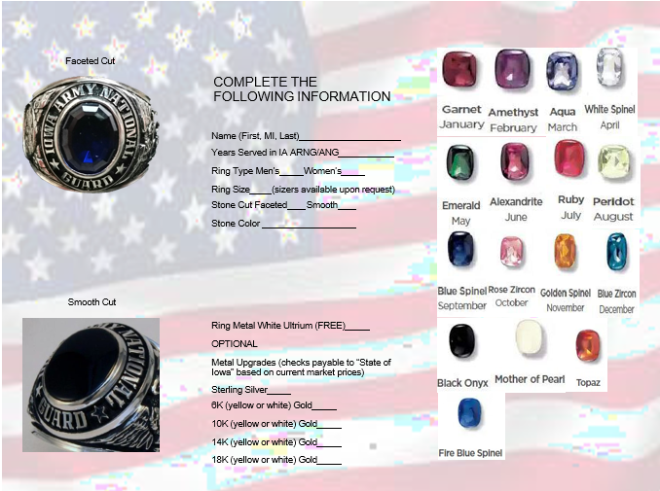

Slide 54

15 MINUTE BREAK

Slide 55
Retirement Request Process
Iowa Army National Guard G1
SFC Joshua Cross - G1 Strength Branch NCOIC

Slide 56
Retirement Request Process
Packet initiated by unit
Must be in receipt of 20-year letter or have a creditable service memorandum from G1
Packet includes
  DA 4187 with Soldier/Commander’s Signature
  Consolidated Exit & Incentives Counseling and Retirement Counseling
  20-year Letter and RC-SBP
Order is cut at G1
Request can/should be made up to one year out
Packets need to be complete NLT 90 days out from retirement

Slide 57
Military Service Obligations
Officers & Warrant Officers Service obligation
  Military funded school attendance (ILE, ROTC/OCS,IPAP, SSC,etc)
  Fed TA
  Post 9/11 Transfer of Educational Benefits (4 yrs)
Enlisted Service obligation
  Military funded school attendance (Sergeant Major Academy, Battle Staff, etc)
  Post 9/11 Transfer of Educational Benefits (4 yrs)
Retired Grade (grade in retired reserves)
  Officer highest grade held satisfactorily (T10 USC 1370a)
    O1-O4: 6 months TIG
    O5 and higher: 3 Years
    Warrants: 31 days
  Enlisted promotion triggers service remaining obligation (3 years E7 and above)
    Voluntary retirement with in the 3 years would require a reduction or waiver at retirement
    ****Submission of a wavier does not mean that it will be approved****

Slide 58
Additional Considerations
  Retirement Ceremony – 5x W’s
  Retirement Awards (You and your spouse)
  Presidential Letter Requests
    30+ years of service are eligible
    9-month request process
  Change of Command/Responsibility timelines
  Administrative Responsibilities prior to retirement
    NCOER/OER completion(s)
    Hand receipt transitions
    Administrative records review
    Medical record review

Slide 59
Additional Considerations
  If you are going to be age 60, be at your reduced retirement pay eligibility date or are a technician that will be able to draw a technician retirement right after your separation date, please make sure your unit is aware and ask them to include a comment on the separation portal entry
  DD 214-1’s are replacing NGB 22’s. DD 214-1’s are being completed at the same time the G1 produces the Discharge Order

Slide 60
Retirement Checklist
Soldier Actions
Unit Actions
Attend Pre-Retirement brief prior to reaching 20-years of service
Receive 20-year letter & immediately complete SBP actions
Request retirement thru unit 9 – 12 months prior to requested effective date
Plan retirement ceremony
Close out evaluation(s)
Complete Sub-Hand receipt actions
Complete BMR & PHA
Obtain iPERMS download
Obtain copies of all medical records
20-year ring (if eligible)
Retirement Award
Retirement Packet completion, with emphasis on remaining service obligation review
Rating Scheme review/update
Ceremony coordination/assistance
OCIE turn-in scheduled
Clear hand receipts
Schedule final PHA
Complete final PHA
Provide disk of iPERMS records to Soldier
Update trackers accordingly
** Reminder contact your unit/RSO if you have had any life altering events (birth of a child, marriage/divorce) to update your RCSBP elections

Slide 61


Retirement!
Last Drill !
Retirement Ceremony
Retirement – 3 months
Retrieve copies of personnel and medical records
Retirement – 6 months
Ceremony planned / announced
At any point in time between receipt of NOE and age 60, but at least 9 months prior to effective date
Pick a date to retire and initiate the packet with your unit retention NCO (Unit responsibilities start here)
20 yrs, 1 month svc
Receive Notice of Eligibility (NOE) to Retire
Meet with unit Retention NCO to verify RPAM statement/eligibility to retire and determine when fully eligible. Complete full Birth month review with emphasis on ERB validation.
19 yrs svc
18 yrs svc
Pick a retirement seminar to attend
Time to start thinking about retirement

Slide 62
Questions?
SFC Joshua Cross - G1 Strength Branch NCOIC
(515) 252-4526

Slide 63

Q: What do you do with your TSP when you retire from uniformed service?
A: Nothing, unless you’re 1) age 59 ½ or older 2) changing address
Q: Can you contribute to TSP after military retirement?
A: Not as a payroll deduction, but can consolidate other IRA’s into the TSP if applicable (uniformed service only)
Q: Are there any important timelines affiliated with TSP?
A: TSP will send a congratulatory letter when notified of retirement with some information for your consideration (ensure address is correct), and another letter when approaching 72 years old. Collection has to begin at age 72, if not started earlier.
Resources:
TSP.gov
SEC.gov
FINRA.gov

Slide 64
SSLI/SGLI
IOWA NATIONAL GUARD ASSOCIATIONS

Slide 65



GESAC: Continue to stay involved
IANG Support to Civil Authorities is a "no fail" mission
Retired NGIA
  Desire to stay in contact with the IANG
  Interested in supporting County of residence and/or adjacent counties
  Willingness to be called upon during a domestic emergency
Vital IANG Mission, Especially During High OPTEMPO
  Initial eyes and ears of the NGIA in the local community
  Provide critical information to the Joint Task Force – Iowa (JTF-IA)
  Help Ensure NGIA’s timely response and effectiveness
Notes:
Job is to establish mutual trust and confidence, coordinating actions to achieve cooperation and unity of effort

Slide 66
Line Of Duty
Health System Services
Notes:
Training notes for Instructor:

Slide 67

AR 600-8-4 Line of Duty Policy, Procedures and Investigations
12 November 2020
AD 2022-04 Sexual Assault Line of Duty Determinations and Reporting, February 2022
ALARACT 021/2022 Line of Duty Requirements and Integrated Disability Evaluation System Referral Memorandum
AR 135-381 Incapacitation of Reserve Component Soldiers 3 January 2021
DA PAM 135-381 Incapacitation of Reserve Component Soldiers Processing Procedures 3 January 2021
DODI 1241.01 Reserve Component Medical Care and Incapacitation Pay for Line of Duty Conditions
DODI 1241.2 Reserve Component Incapacitation System Management
AR 40-3 Medical, Dental and Vet Care
AR 40-501 Standards of Medical Fitness
AR 635-40 Personnel Separations, Physical Evaluation for Retention
AR 15-6 Procedures for Investigating Officers and Boards of Officers
Notes:
Training notes for Instructor:

Slide 68

The Army LOD Program is a commander’s program which essentially protects the interest of both the Soldier and the U.S. Government in the event service is interrupted by injury, illness, disease, or death.

Slide 69
Purpose of Line of Duty Investigations
Protects Soldiers’ interest
Protects Government’s interest
Documents condition for Medical Evaluation Board/Physical Evaluation Board (MEB/PEB) processing if permanent disability results
Documents “service incurred or aggravated” for Veterans
Administration benefits
Payment of incapacitation pay
Payment of authorized medical/dental bills
Authorization of emergency care/military care

Slide 70
WHEN IS AN LOD REQUIRED?
AR 600-8-4, 2–2. Requirements for line of duty investigations
An LOD investigation will be conducted for all Soldiers, regardless of Component if the Soldier experiences a loss of duty time for a period of more than 24 hours and—
(1) The injury, illness, or disease is of lasting significance (to be determined by a physician, physician assistant, or nurse practitioner) (see para 5–4b for other guidance);
(2) There is a likelihood that the injury, illness, or disease will result in a permanent disability;
(3) If an RC Soldier requires follow-on care for an injury, illness, or disease incurred during a period of active duty.

Slide 71
WHEN IS AN LODI REQUIRED?
Whenever healthcare is needed for a condition incurred while in a duty status
Injuries from motor vehicle accidents (MVA)
Hospitalizations
Fractures (ex. ankle, finger, wrist, hand)
Head injuries (ex. concussion, migraine, traumatic brain injury (TBI))
Any injury, illness or disease requiring care AFTER the end of the training period
AGR Soldier

Slide 72
WHEN IS AN LODI REQUIRED?
Diseases
Existed Prior to Service (EPTS) conditions (peptic ulcer disease, kidney stones, asthma, hypertension, diabetes, diverticulitis, leukemia, cysts)
Joint injuries (hip, knee, shoulder)
Allergic reactions that require follow on care or has lasting significance
When directed or requested

Slide 73
LINE OF DUTY POLICY UPDATE
Effective 15 April 2019, Soldiers will have up to 180 days following the completion of their qualified duty to request consideration for a line of duty determination, absent special circumstances. Special circumstances are those in which the covered condition pre-dates the 180 day period, for example, latent onset symptoms of post-traumatic stress and unreported Sexual Assault in accordance with AR 600–8–4, paragraph 4–4c. (AR 600-8-4, 5-4)
Applies to all Soldiers regardless of RC status, M-Day, Title 10 and Title 32 AGR
LODs for injuries, illnesses, or diseases that has no lasting effect on Soldier’s overall health (defined as not requiring follow-up care) or military career, will not be accepted
LOD Approval Authority will change to:
- Title 32 LOD – NGB Approval Authority
- All T-10, Formal LOD – NGB Approval Authority
eMMPS to reflect PPOM Implementation July 2017

Slide 74
LINE OF DUTY POLICY UPDATE
Exceptions to Policy for LOD submissions
- Behavioral Health
- Sexual Assault
- At not fault of the soldier (Proof on soldier)
- Soldier who are enrolled in DES and LOD is directed by the HRC
An ETP can only be approved by HRC

Slide 75
LINE OF DUTY DETERMINATIONS
  IN LINE OF DUTY (ILD)
  IN LINE OF DUTY-Existed Prior to Service, Service Aggravations (ILD-EPTS-SA)
  IN LINE OF DUTY- THIS EPISODE ONLY (ILD-This Episode Only)
  NOT IN LINE OF DUTY-NOT DUE TO OWN MISCONDUCT (NLD-NDOM)
  NOT IN LINE OF DUTY-DUE TO OWN MISCONDUCT
  (NLD-DOM)
  NOT IN LINE OF Duty – EPTS –No Service Aggravations (NLD-EPTS-NSA)
  Presumptive In Line of Duty (Reserve for HRC Only)
  LOD- No Findings (Reserved for HRC Only)

Slide 76
TWO TYPE OF LINE OF DUTY
INFORMAL LINE OF DUTY
Title 10 NGB Approved
OCONUS NGB Approved
Assault (Restricted/Unrestricted) NGB Approved
Title 32 NGB Approved
M – Day NGB Approved
FORMAL LINE OF DUTY
Title 10 NGB Approved
OCONUS NGB Approved
Title 32 NGB Approved
M – Day NGB Approved

Slide 77
HSS Staff
CW3 Tyson Brian, HSS OIC - ​tyson.w.brian.mil@army.mil, 515-334-2879
SFC Brandi Millikan - brandi.l.millikan.mil@army.mil, 515-334-2891
SGT Kylie Clark - kylie.m.clark3.mil@army.mil , 515-252-4628

Slide 78
Medical Records Staff
SFC Ramsey, Joshua - ​joshua.e.ramsey.mil@army.mil, 515-252-4982

Slide 79
QUESTIONS

Slide 80
Veteran Affairs
Gavin Sandvig

Slide 81


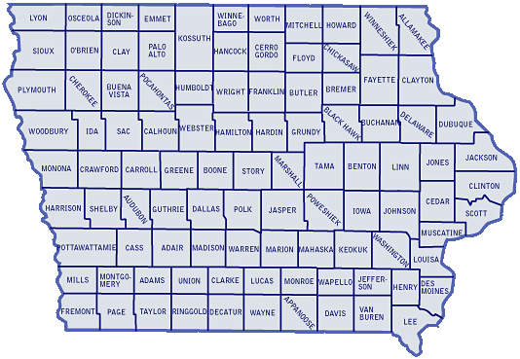


Iowa Veterans Benefits (IVB)
Camp Dodge
Iowa Veterans Home (IVH)
Marshalltown
Iowa Veterans Cemetery (IVC)
Van Meter
IDVA Website:
https://dva.iowa.gov

Slide 82
Todd Jacobus
Commandant, Iowa Department of Veterans Affairs (IDVA)
1301 Summit Street, Marshalltown, Iowa
todd.jacobus@ivh.state.ia.us
Gavin Sandvig
Bureau Chief, Veterans Benefits & Veterans Cemetery, IDVA
Camp Dodge, Bldg. W41/3465
7105 NW 70th Avenue
Johnston, Iowa 50131-1824
gavin.sandvig@iowa.gov
Office: 800-838-4692 or Mobile: 641-758-5318

Slide 83
Iowa Veterans Benefits (IVB)
Camp Dodge, Bldg. #3465
7105 NW 70th Avenue
Johnston, IA 50131-1824
Office Phone: 800-838-4692, 515-252-4698 or Fax 515-727-3713
Iowa Veterans Home (IVH)
1301 Summit St.
Marshalltown, IA 50158-5485
Office Phone: 800-645-4591, 641-752-1501 or Fax 6415-753-4278
Iowa Veterans Cemetery (IVC)
34024 Veterans Memorial Drive
Adel, Iowa 50003
Office: 515-996-9048 Fax: 515-996-9102

Slide 84
County Veterans Service Officers
  YOUR PRIMARY Point of Contact for benefits
  Visit https://dva.iowa.gov/county-veteran-service-offices
  State of Iowa Code
    Chapter 35.1. Definition of a Veteran
  Assistance with Federal VA Programs and Services
    Visit https://www.va.gov/

Slide 85
Iowa Veterans Benefits (Camp Dodge Office / Bldg. W41/3465 )
Repository for DD 214s and IA Veterans Graves Registration Records
Veterans Trust Fund for Veterans and Surviving Spouses working with the Iowa Commission of Veterans Affairs (ICVA)
Injured Veterans Grant Program working with the ICVA
Special “Veterans-type” License Plates working with Iowa Department of Transportation (IDOT)
Veterans designation on Drivers License and/or Identification Card working with IDOT
IFA’s Military Home Ownership Assistance Program working with Iowa Finance Authority
Honor Guard Reimbursement Program for Veteran burials

Slide 86
Other Veterans Benefits
Disabled Veteran Homestead Property Tax Credit
Military Service Property Tax Exemption
Vocational Rehabilitation
Lifetime Hunting/Fishing License for Resident, Disabled Veteran working with Iowa Department of Natural Resources (DNR)
Annual Hunting/Fishing License for Resident Armed Forces Veteran working with Iowa DNR

Slide 87
Other Veterans Benefits
Waiver of VA Disability Compensation to draw drill pay and annual training pay
Assistance with VA Benefits including VA Pension Claims, VA
Survivors' Dependency and Indemnity Compensation (DIC) Claims
Surviving Spouse Pension
Burial Flag for Veterans Death, and Headstone or Marker for Veterans buried in private and public cemeteries

Slide 88

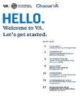

VA Regional Office
Des Moines (Federal)
Public Contact Team
210 Walnut St., Suite 977
Des Moines, IA 50309
Main line: 800-827-1000
Office phone: 515-323-7464
Office Fax: 515-323-7583
Des Moines VA Medical Center
  3600 30th Street
Des Moines, IA 50310-5753
Main phone: 515-699-5999
Mental health care: 515-699-5807
Find other VA Locations
link : https://www.va.gov/find-locations/
Health Care Benefits Overview 2023, Vol 2 link : https://www.va.gov/healthbenefits/resources/publications/IB_10-185_Health_Care_Overview_2023.pdf
Websites:
https://www.va.gov/getstarted/

Slide 89
QUESTIONS?

Slide 90

LUNCH BREAK

Slide 91


Welcome!
UNCLASSIFIED
Iowa Army National Guard
Education Service Center
The education & incentives branch

Slide 92


LIKE OUR FACEBOOK PAGE
UNCLASSIFIED
Iowa Army National Guard Education & Incentives

Slide 93
Email and Phone
UNCLASSIFIED
(515) 252-4468
ia.arng.esc@army.mil

Slide 94
Agenda
UNCLASSIFIED
GI Bill® Programs – Post 9/11
Transfer of Education Benefit (TEB)
Federal Tuition Assistance (FTA) and Credentialing Assistance (CA)
Iowa National Guard Service Scholarships (INGSS)
Point of Contacts
GI Bill® is a registered trademark of the U.S. Department of Veterans Affairs (VA). More information about education benefits offered by VA is available at the official U.S. government Web site at www.benefits.va.gov/gibill.

Slide 95

GI Bill Programs
UNCLASSIFIED

Slide 96
Post-9/11 GI Bill (Ch 33)
UNCLASSIFIED
What Is It?
  A GI Bill Program for Soldiers who served on Active Duty
How Do I Qualify?
  Served at least 90 days in a period of qualifying active duty on/after Sep 11, 2001
  Qualifying Active Duty service is:
    Service in any active component: Title 10 USC, Sections 688, 12301(a), 12301(d), 12301(g), 12301(h), 12302, 12304, 12304a, or 12304b
    Title 10 or 32 AGR
    Title 32 USC, Section 502(f):
      Between 11 Sep 2001 – 31 May 2002, in support of Operation Noble Eagle
      Between 15 Feb 2019 – 20 Jan 2021 in support of Operation Guardian Shield
      Between 22 Mar 2020 – 01 Jul 2022 in response to COVID-19
      Between 11 Jan 2021 – 23 May 2021 Presidential Inauguration Support
    Awarded a Purple Heart
    Serve in a qualifying duty status for more than 30 days and separate due to a service-connected disability or injury

Slide 97
Post-9/11 GI Bill (Ch 33)
UNCLASSIFIED
What Do I Get?
Service Requirements on/after 9/11/01 an individual must serve an aggregate of | Payment Tiers Percentage
At least 36 cumulative months or Purple Heart award | 100%
At least 30 continuous days on active duty and discharged due to service-connected disability | 100%
At least 30 cumulative months | 90%
At least 24 cumulative months *IADT (BCT/AIT/BOLC) may be added after completion of 24mo qualifying service | 80%
At least 18 cumulative months | 70%
At least 6 cumulative months | 60%
At least 90 aggregate days | 50%
* Payment Tier applies to Tuition & Fees, Books & Supplies Stipend, and Housing Stipend

Slide 98
Post-9/11 GI Bill (Ch 33)
UNCLASSIFIED
Non Qualifying Service:
  Title 32 FTNGD-OS/ADOS/ADSW (Other than previously noted)
  Service Academy Contract Period
  ROTC Active Duty Contract Period
  Active Duty used for Active Duty Loan Repayment
  Active Duty period receiving less than Honorable discharge
Basic Training and AIT:
  Can be added to established qualifying time if:
    You already completed 24 months of other qualifying active duty time; and
    Your Basic Training and/or AIT occurred on or after 9/11/2001

Slide 99
Post-9/11 GI Bill (Ch 33)
UNCLASSIFIED
What Do I Get? Continued,
  Tuition and Fees
    Pays up to 100% of in-state tuition and fees at public schools
    Pays private and out-of state tuition and fees up to the VA cap of $27,120.05 annually
    Payments made directly to the school
  Housing Stipend
    If not on active duty and receiving BAH
    Children receive regardless if transferred
  Books and Supplies
    Paid directly to the student
    Up to $1,000 per academic year
Period of Use
  If last date of qualifying duty is before 1 January 2013, eligibility expires 15 years from date of last Active Duty discharge
  If last date of qualifying duty is on/after 1 January 2013, eligibility does not expire

Slide 100
How to Apply for VA Benefits
UNCLASSIFIED
Apply On Line at: www.va.gov to receive your Certificate of Eligibility (COE)
Information Needed
  School name and course of study
  Personal Information (Address, Phone, etc…)
  Bank account routing number and account number
Supporting Documents
  DD214 and/or Orders (Title 10 Mobilizations, Title 10 AGR/ADOS, Title 32 AGR)
  Ensure all orders/DD 214s and current NGB 23 are in your iPERMS record (Records of qualifying service!)
For VA Education Support
  Call 1-888-GIBILL-1 (1-888-442-4551)

Slide 101
Transfer of Education Benefit (TEB)
UNCLASSIFIED
What Is It?
  A GI Bill Incentive Program that allows Soldiers to transfer their Post-9/11 GI Bill benefits to spouse/dependents in exchange for continued service.
How Do I Qualify?
  Be currently serving in the Armed Forces, and
  Have completed at least 6 years in the Armed Forces on date of request, and
  Not have any adverse action flag (including APFT/ABCP failure) on date of request, and
  Agree to serve 4 years from the date of request
Important!
*Must initiate transfer of benefits while serving in the Armed Forces
*After retiring or separating, can revoke or modify only existing transferred benefits

Slide 102
Transfer of Education Benefit (TEB)
UNCLASSIFIED
What Do I Get?
  May transfer remaining months of Post-9/11 benefit or up to 36 months of benefits, whichever is less
  DEERS Eligible Dependents;
    Spouse
      Can use immediately after receiving approved TEB
      Same payments and delimiting date as transferring Soldier
    Children
      Must transfer before child turns 21 (before 23 if a full-time student)
      Can use after SM has served at least 10 years in the Armed Forces
      Can use as early as age 18 or receipt of HS completion equivalent cert.
      Ends at age 26 or when benefits are exhausted, whichever comes first

Slide 103
Transfer of Education Benefit (TEB)
UNCLASSIFIED
How Do I Apply?
TEB Process:
  Step 1: Contact the DVA at 1-888-422-4551 (888-GIBILL-1) to determine how
many months are available to be transferred
  Step 2: Complete a DA Form 4836 Extension of Enlistment (if needed) with unit
  Step 3: Ensure extension and current NGB 23 is uploaded into iPERMS
  Step 4: Apply to transfer benefits on-line at: https://milconnect.dmdc.osd.mil/milconnect/
    Follow instructions sent to your gov email by NGB Education Support Center (ESC)
  Step 5: Return to milConnect, print approval letter, write down your ‘Obligation End Date’ (OED) and/or burn it into memory
Don’t wait, submit your TEB request TODAY!

Slide 104
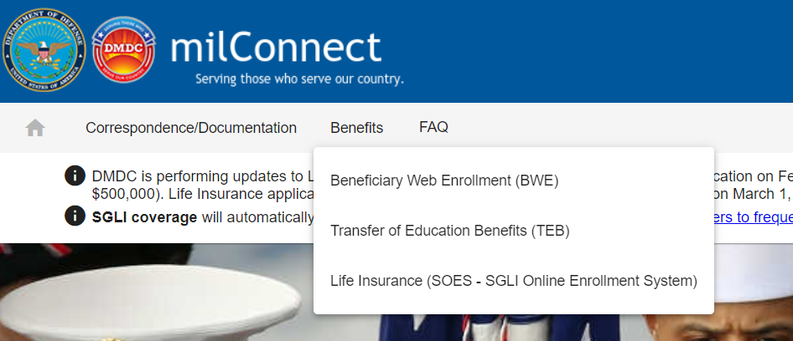
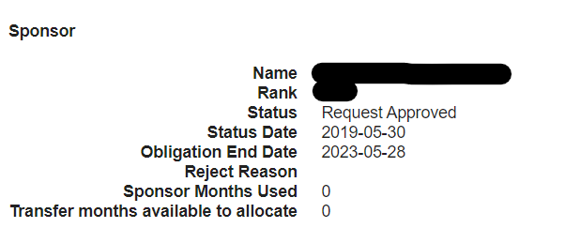
Transfer of Education Benefit (TEB)
UNCLASSIFIED
VERY IMPORTANT SLIDE!!!
If you voluntarily retire prior to your TEB OED you INVALIDATE your TEB agreement and it is gone!
Any already used benefits by a dependent will be collected by the VA to the penny, and your dependent gets the collection notice!

Slide 105

Federal Tuition Assistance
UNCLASSIFIED

Slide 106
Federal Tuition and Credentialing Assistance
UNCLASSIFIED
These benefits remain available until retirement/ separation, however...
Service Obligation from Use:
    Commissioned Officers/Warrants (2 years ADSO if Active/AGR, 4 years RDSO if USAR/ARNG)
    Enlisted: complete funded courses prior to separation
Not meeting service obligation (requesting retirement before OED) triggers recoupment for full amount of funded courses not met.
Contact the education office for full program benefits, qualification criteria, and questions.

Slide 107

Iowa National Guard
Service Scholarship (INGSS)

Slide 108
Iowa National Guard Service Scholarship (INGSS)
UNCLASSIFIED
This benefit remains available until retirement/ separation.
Benefit restricted to undergraduate coursework towards until first bachelors-level degree is achieved
No Service Obligation from Use.
Contact the education office for full program benefits, qualification criteria, and questions.

Slide 109
Joint Services Transcripts
UNCLASSIFIED
Joint Service Transcripts: https://jst.doded.mil
Get your military training analyzed for course credit
You can still use this service after leaving the service. Register for a non-CAC account.

Slide 110



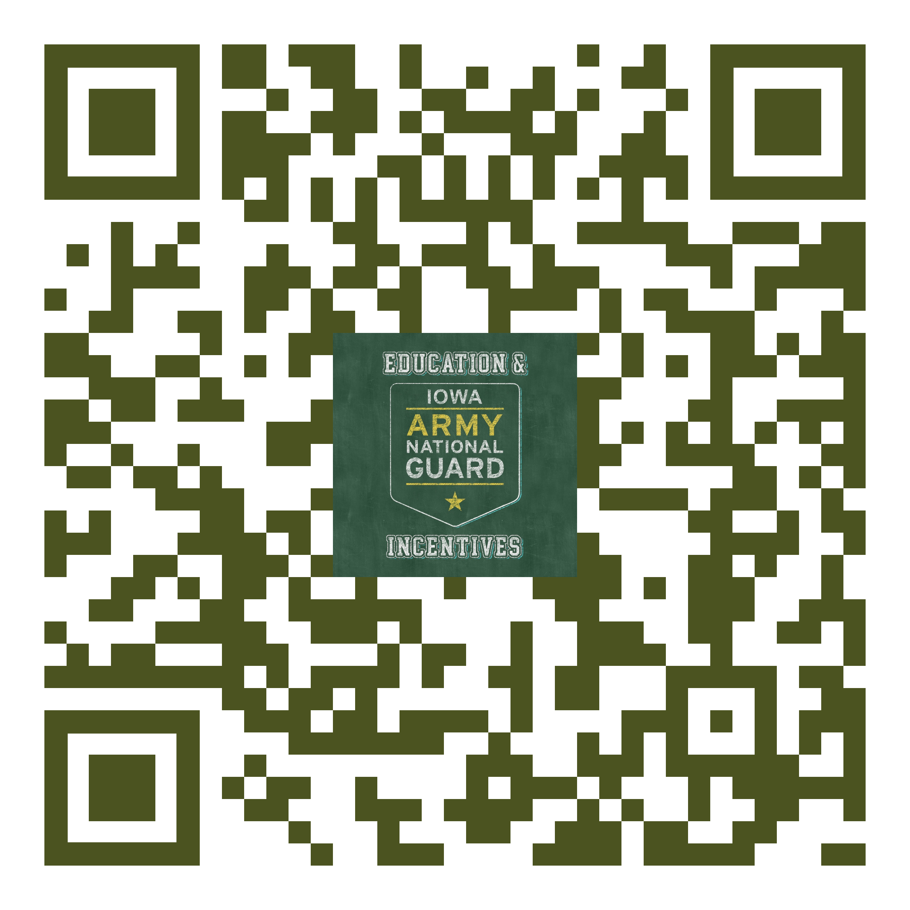

Questions?
UNCLASSIFIED

Slide 111
DEERS
Office: (515) 252-4728

Slide 112
DEERS DATABASE
Benefits Database For:
-Sponsor ID
-Dependent ID
-Tricare
-Dental
-Vision
-MWR
-Commissary

Slide 113
Who gets an ID card ?
Sponsor
Spouse
Children ages 10 to 21 – UNMARRIED
Children not living in the sponsor’s household
Step-Children living in the sponsors household with a different last name
Children ages 21 to 23 if fulltime college memo is provided from the school
Children ages 21 to 26 if purchasing TRICARE Young Adult
Permanently Incapacitated children

Slide 114

Retired ID card
DD Form 2 Armed Forces of The United States Geneva Conventions Identification Card (Reserve) and DD Form 2 (Retired Reserve)
Retired Reserve Entitlements:
PX/Commissary/MWR
Space A Travel
Tricare Retired Reserve

Slide 115
DEERS Reminders
Power of Attorney (POA) holder can make changes to a Sponsors DEERS Database
1172-2 (is required to be produced from a DEERS Machine by a credentialed operator or through ID card office Online with your DS Logon.)
90 Days from Qualifying Life Event (QLE) When coming in for an ID card you will
need TWO forms of UNEXPIRED ID
Primary: Driver's license
Secondary: Social Security card, Passport, Birth Certificate

Slide 116
20/20/20-20/20/15 Rule
Divorced Spouse – 20/20/20 or 20/20/15 Rule
20 = At least 20 years of Marriage
20 = Sponsor at least 20 years creditable service
20/15 = Overlap of marriage and creditable service
Must apply to DEERS National Office for determination. If approved, then former spouse has TRICARE for remainder of life only if they DO NOT remarry.

Slide 117
Getting your dependent an ID Card
Sponsor has FOUR options to assist dependent in ID Card renewal
Sponsor and dependent visit ID Office together
1172 (90 Days)
Power of Attorney DS Logon

Slide 118
ID Card Office Online
DS Logon
Access ID Card Office Online (https://idco.dmdc.osd.mil/idco/)
Select “Renew / Replace Family ID Cards” and follow the instructions.
Process generates a digitally signed DD Form 1172-2 into your dependents DEERS Record.
Select ID Card Office Locator & Appointments
Reminder: Not all locations do appointments

Slide 119

QUESTIONS

Slide 120

15 MINUTE
BREAK

Slide 121
TRICARE

Slide 122
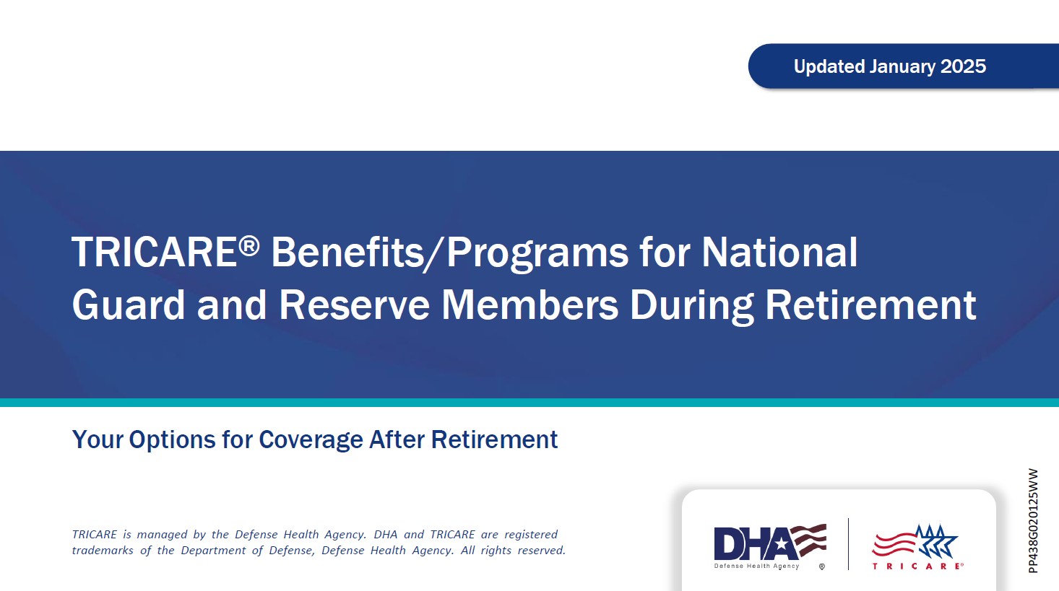

Slide 123
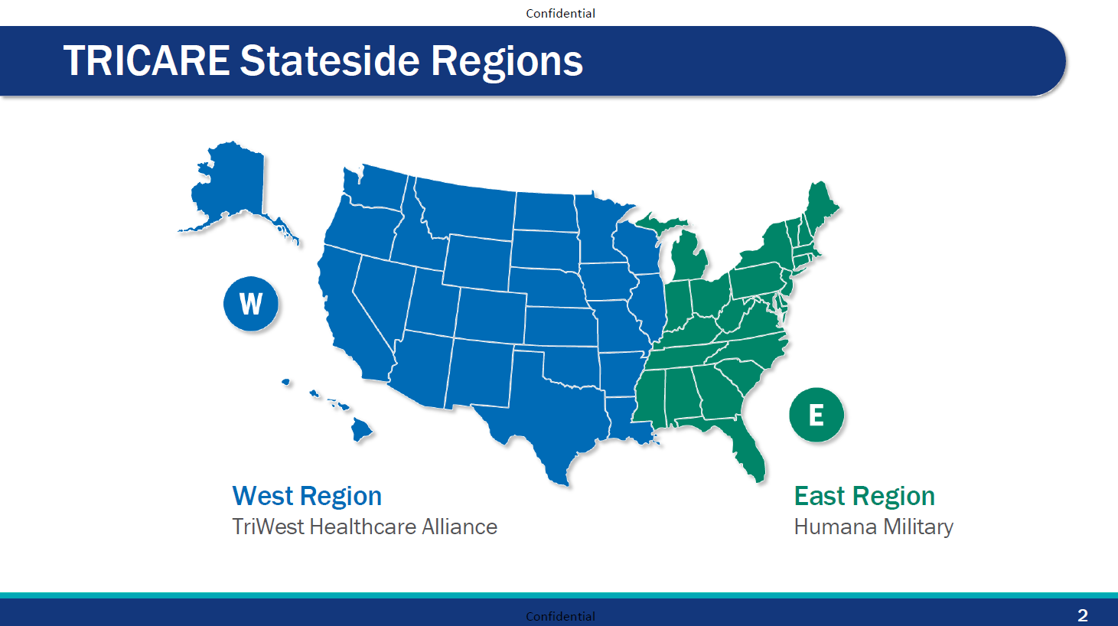

Slide 124
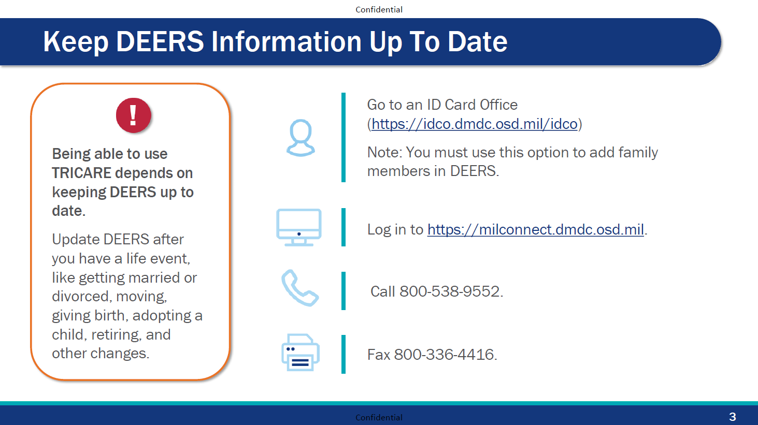

Slide 125
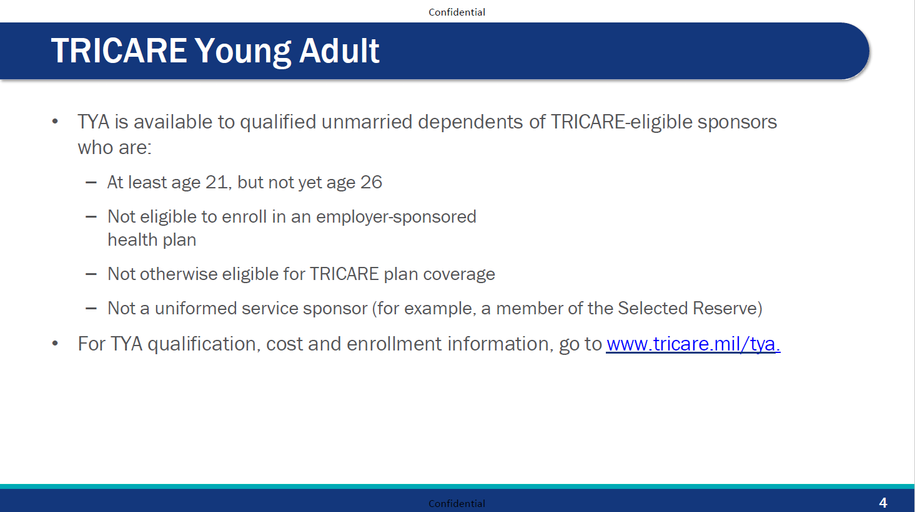

Slide 126
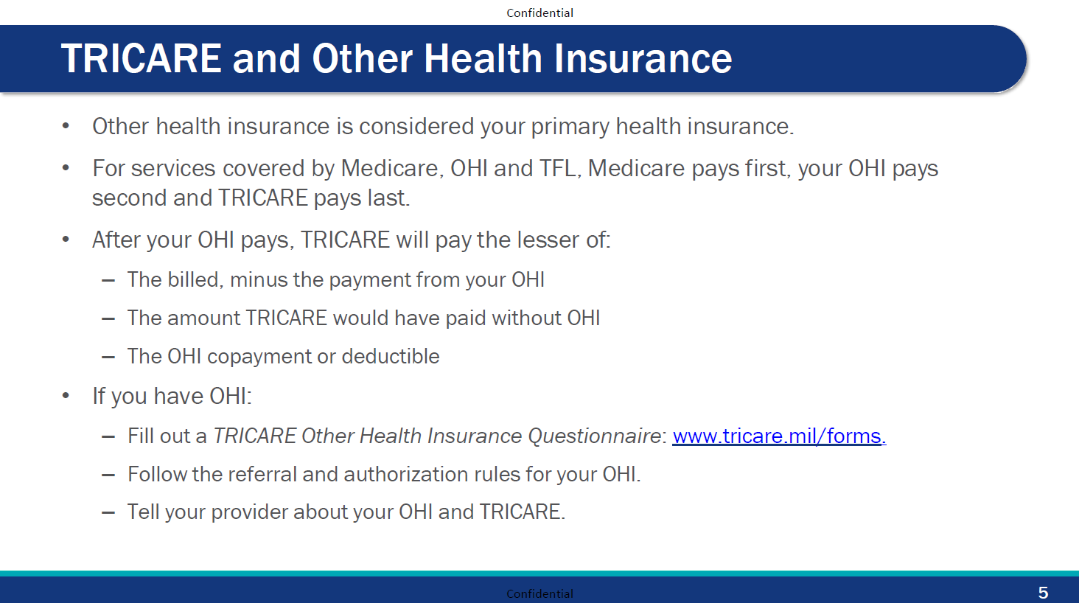

Slide 127
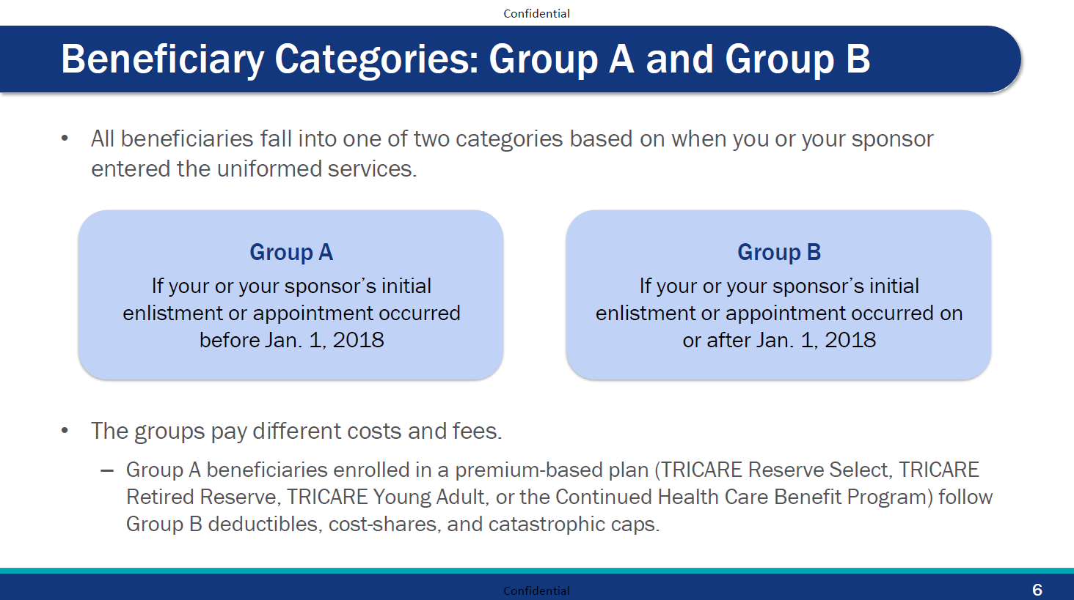

Slide 128
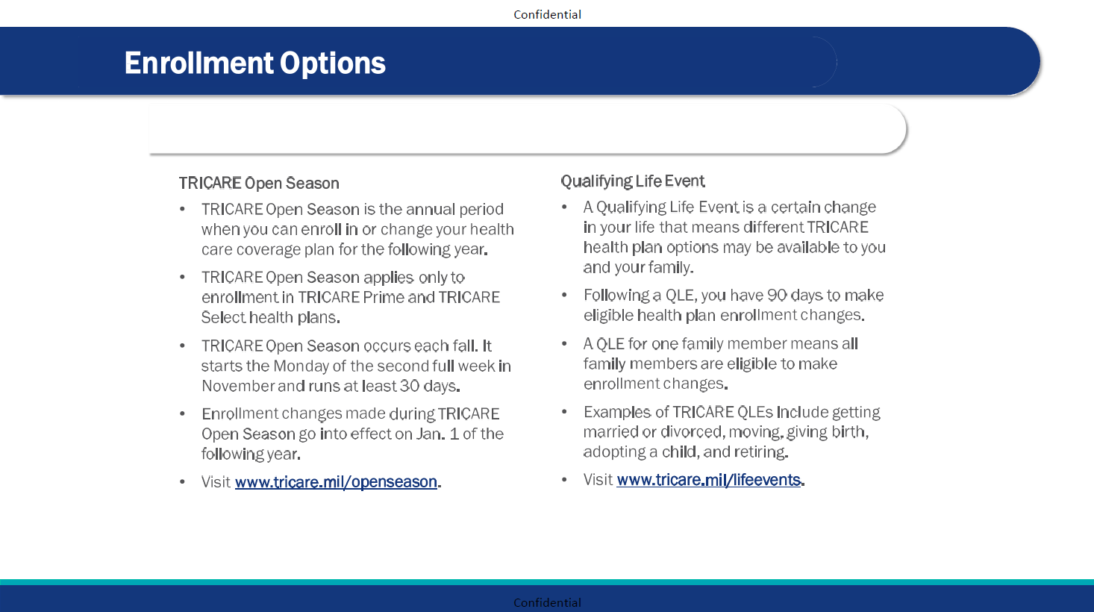
7

Slide 129
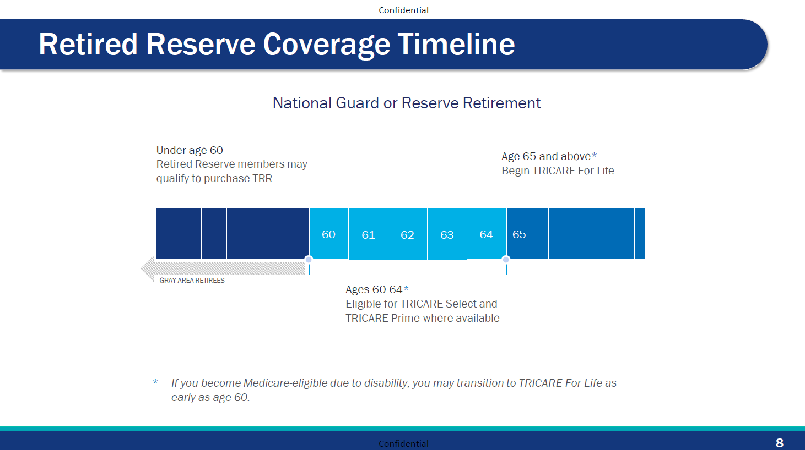

Slide 130
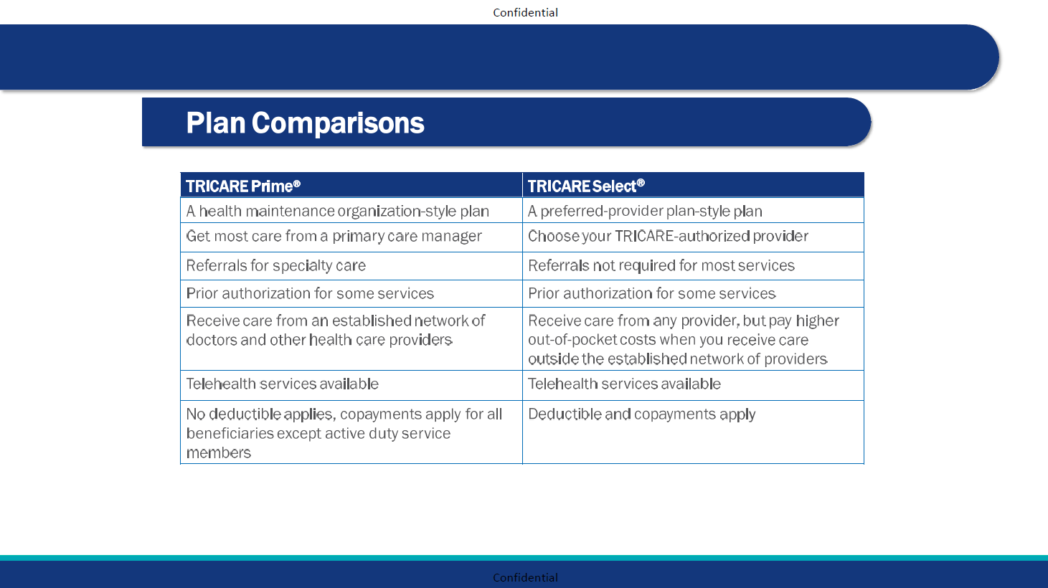
9

Slide 131
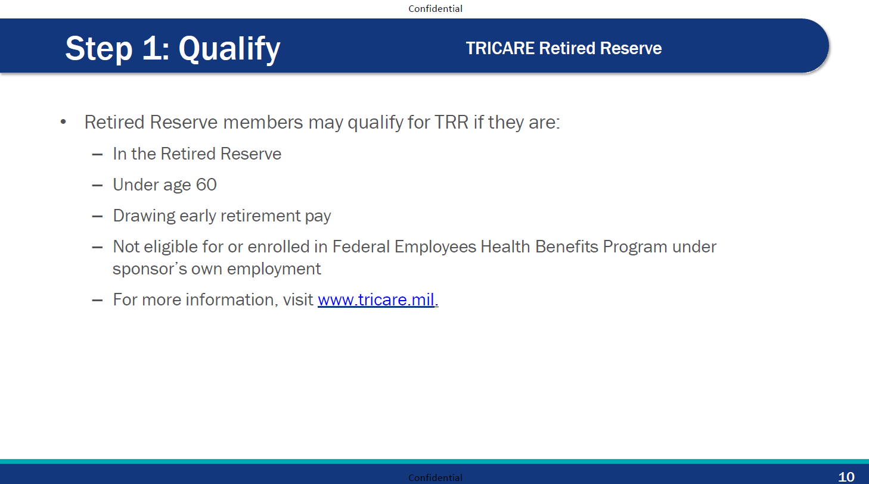

Slide 132
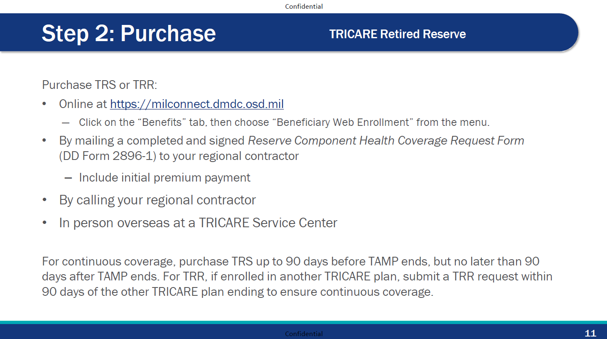

Slide 133
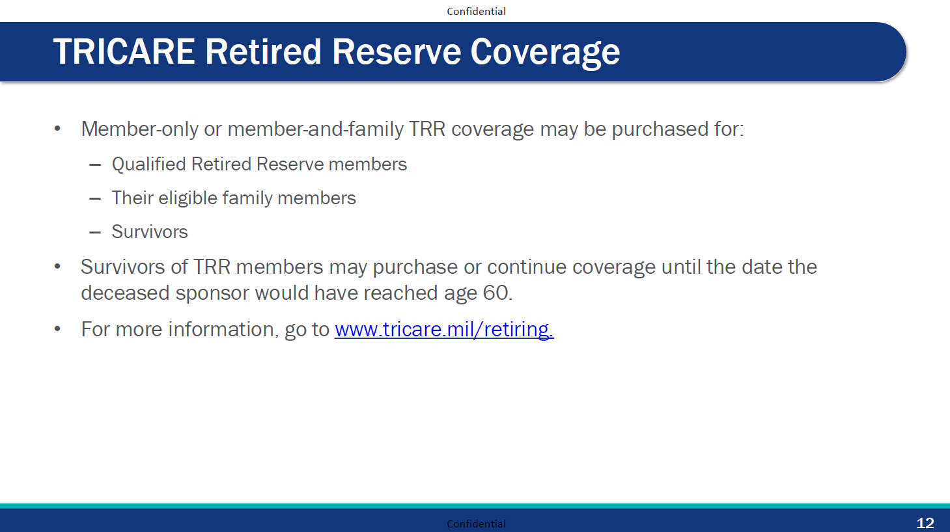

Slide 134
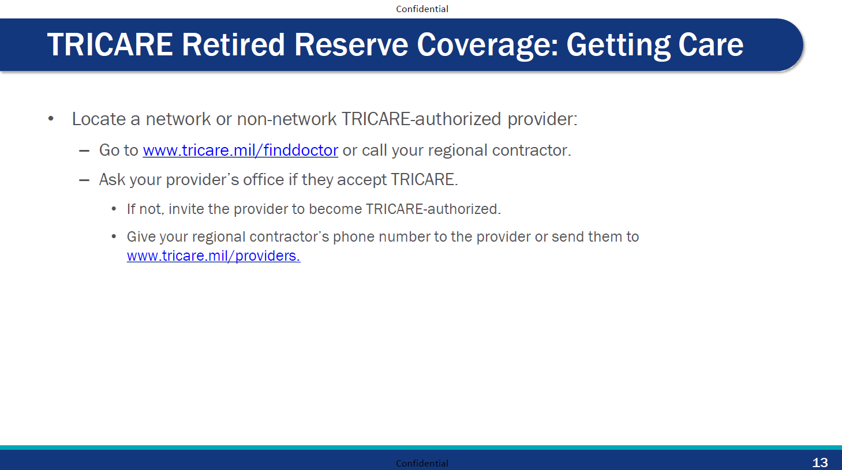

Slide 135
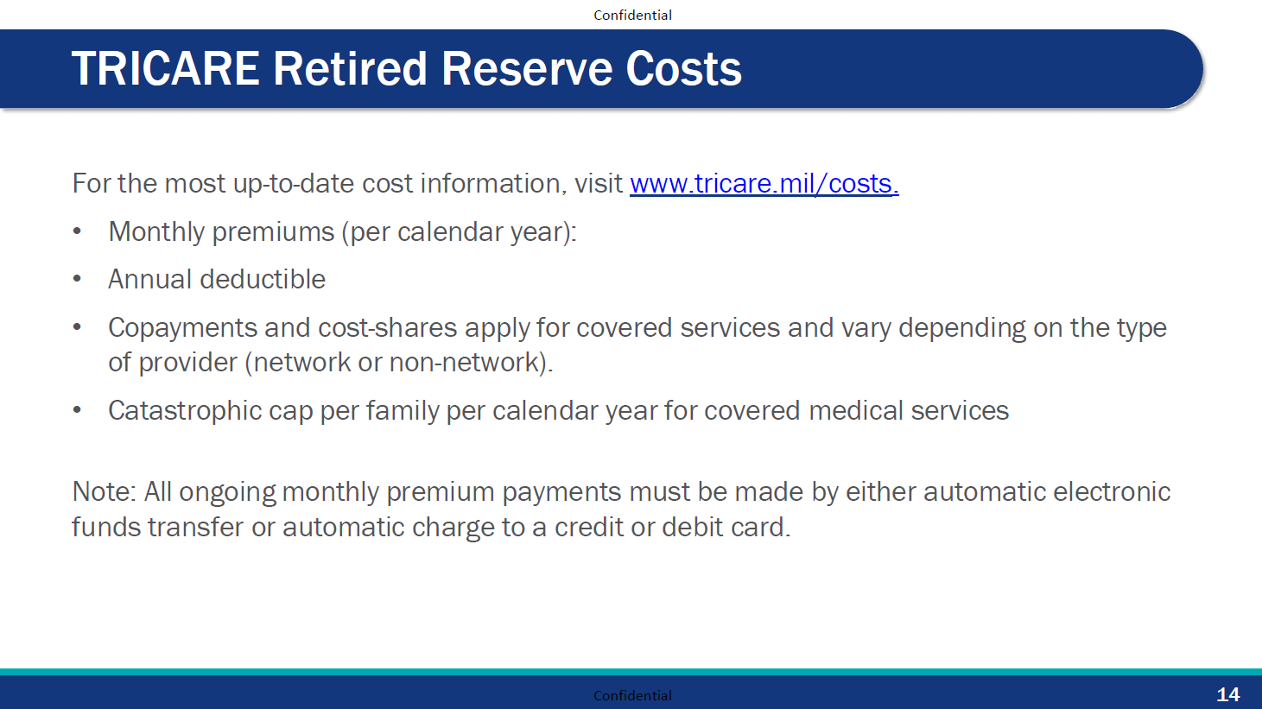

Slide 136
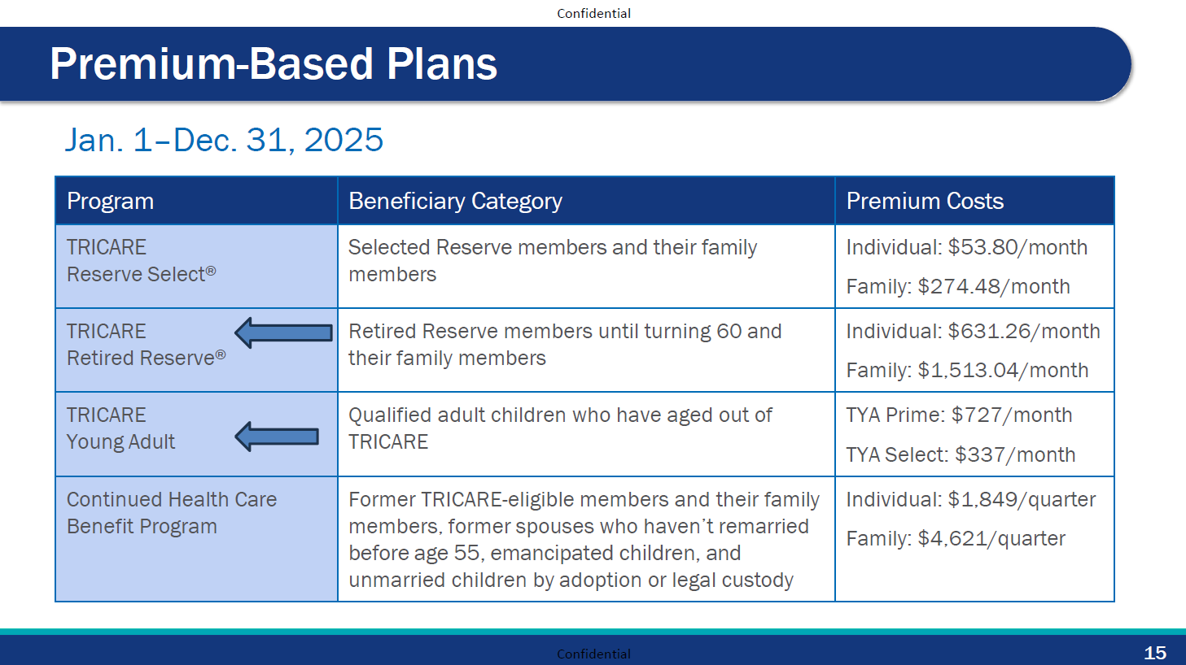

Slide 137
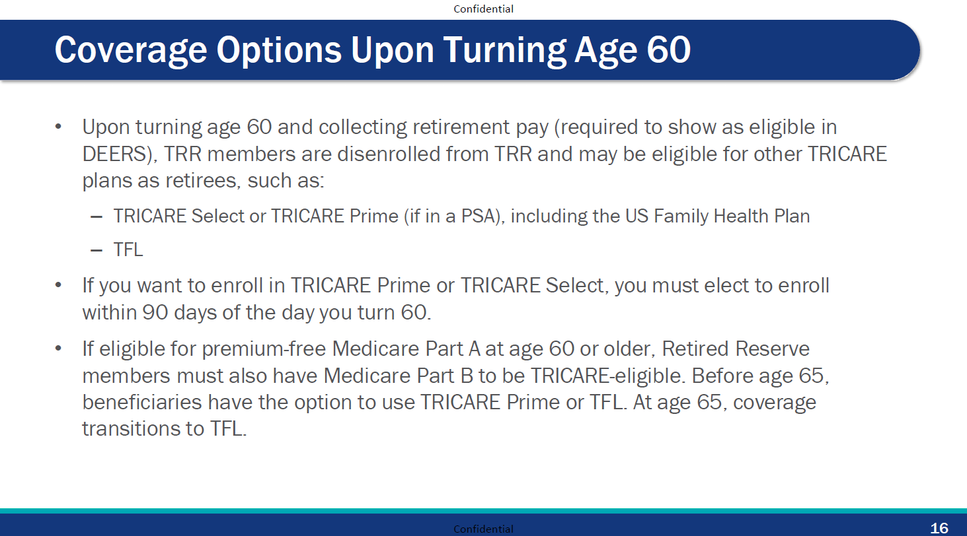

Slide 138
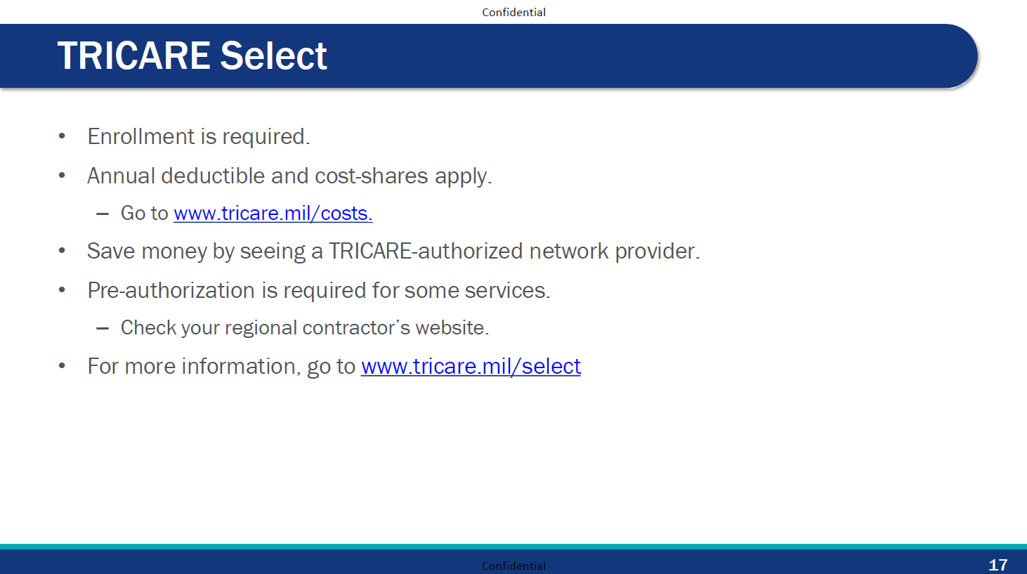

Slide 139
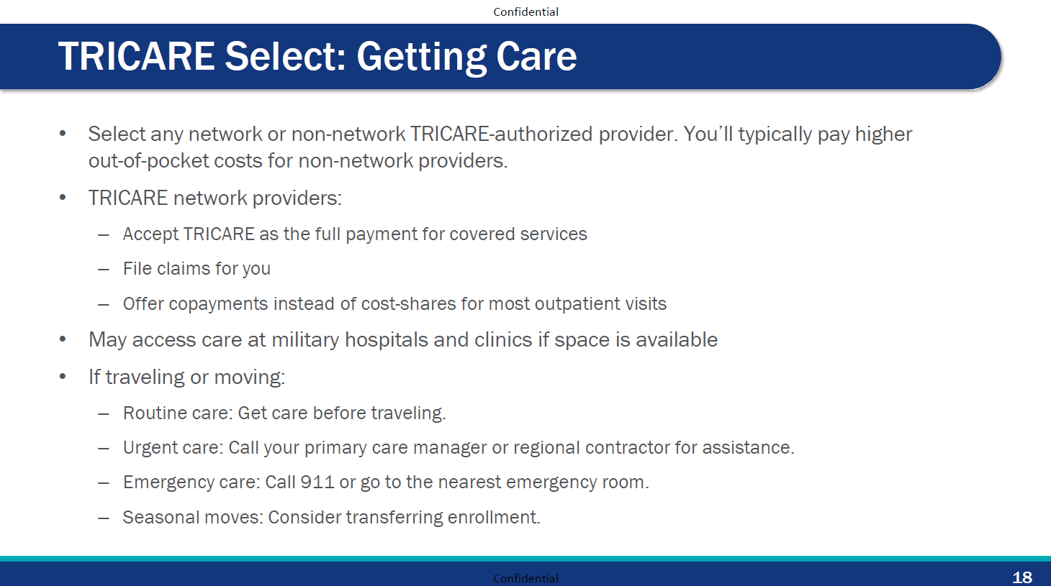

Slide 140
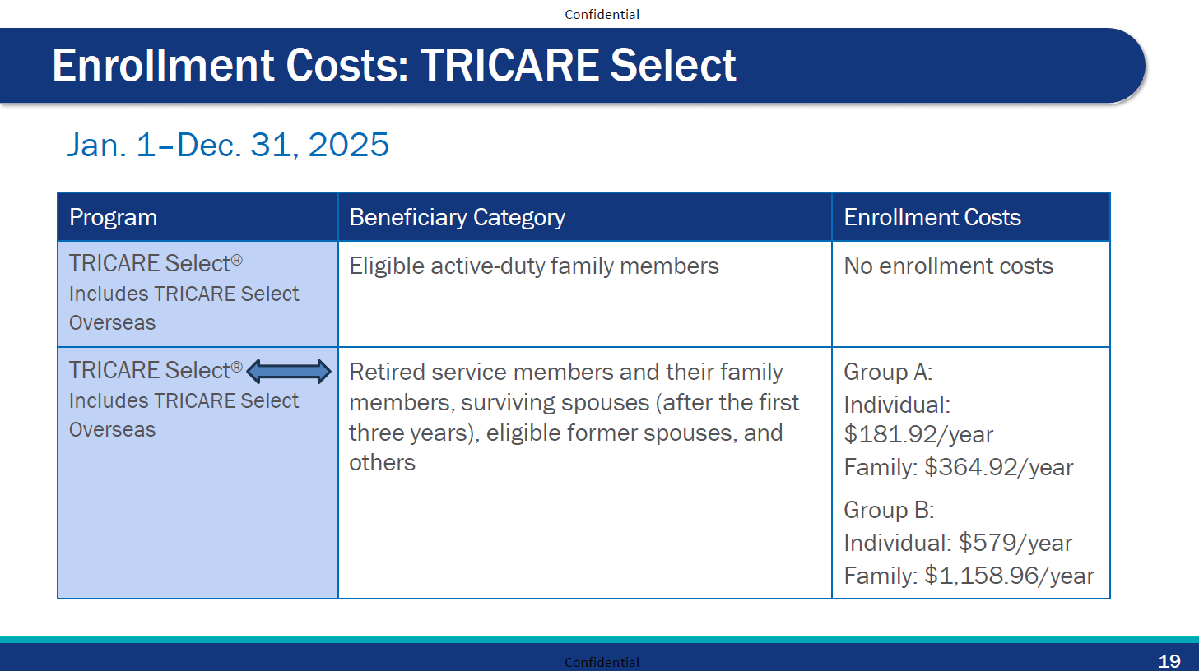

Slide 141
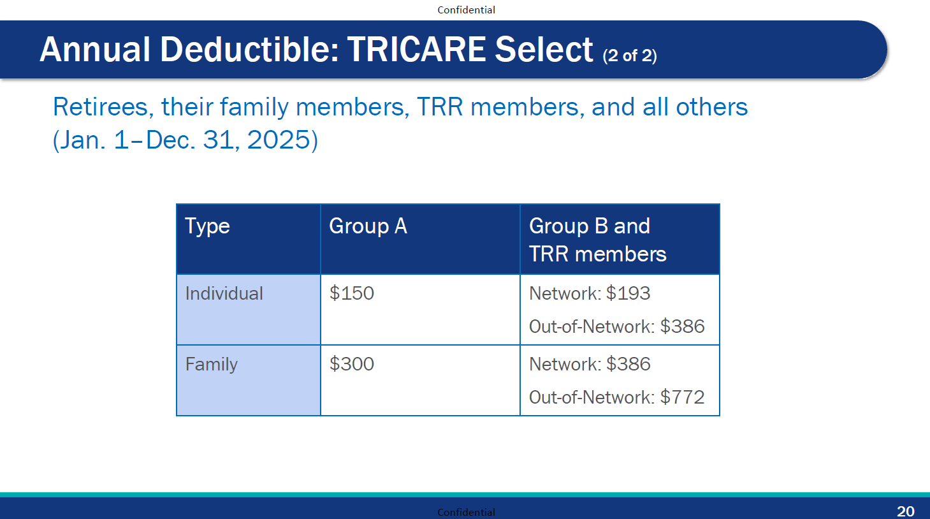

Slide 142
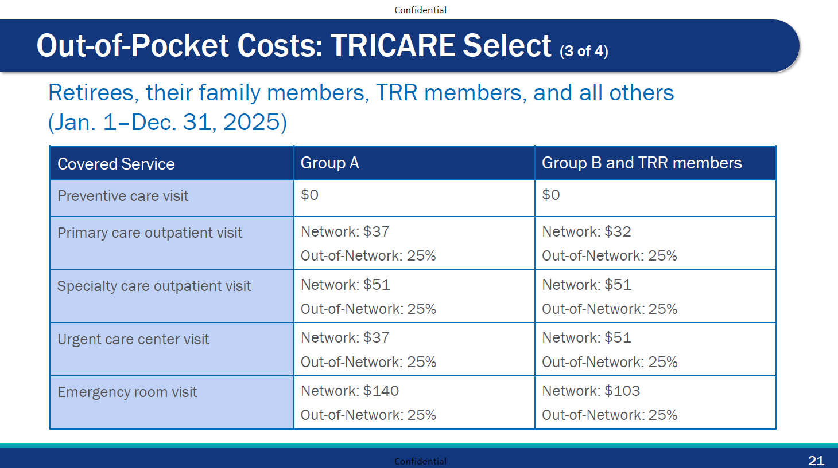

Slide 143
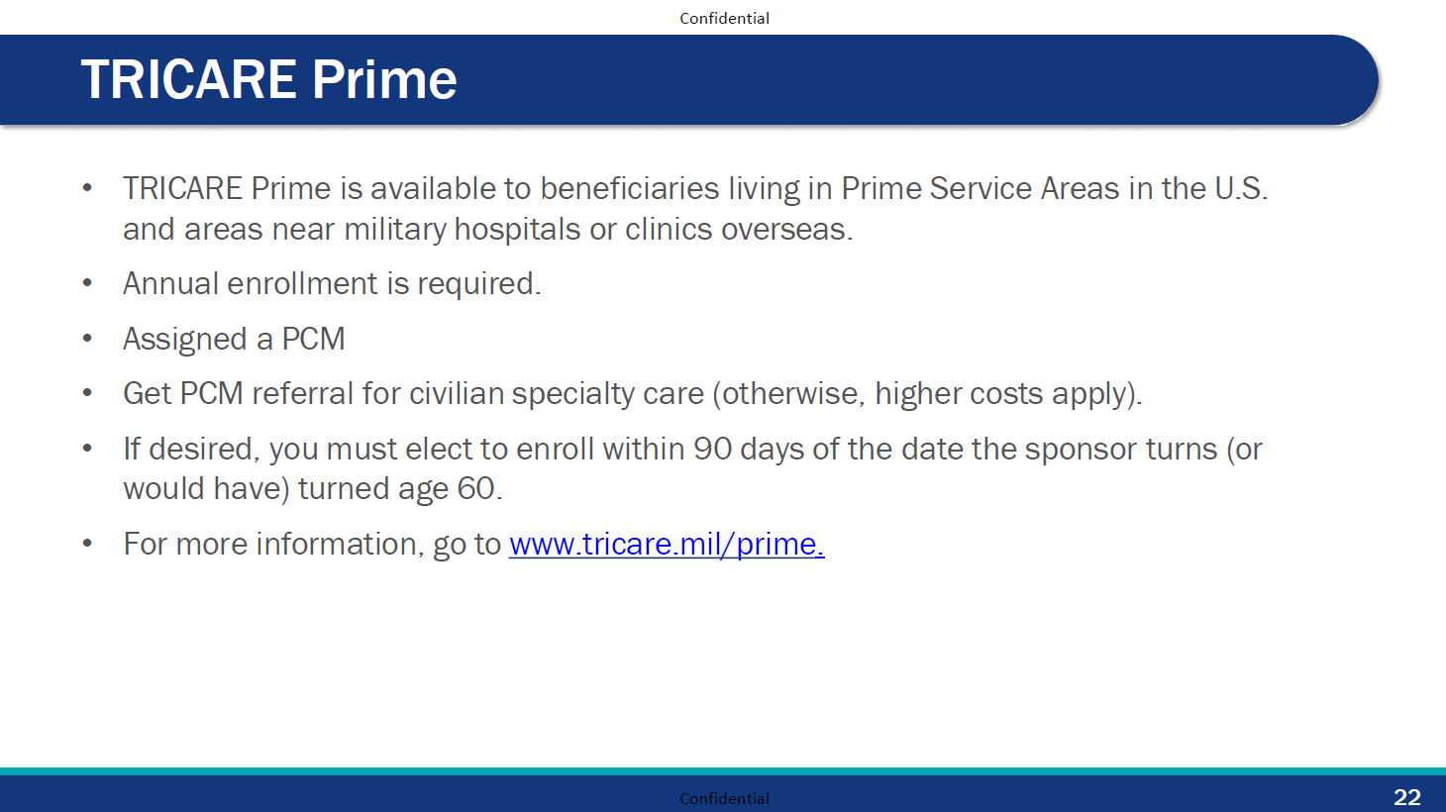

Slide 144
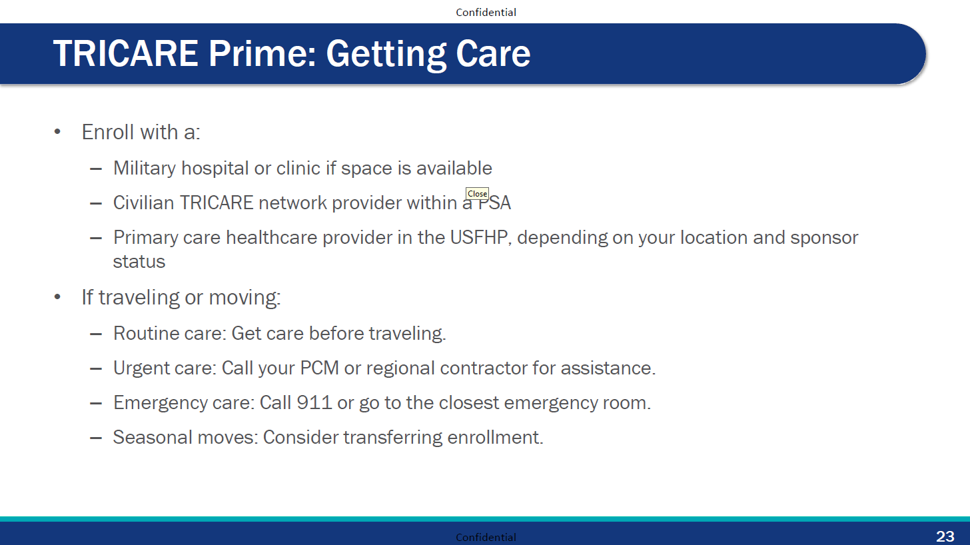

Slide 145
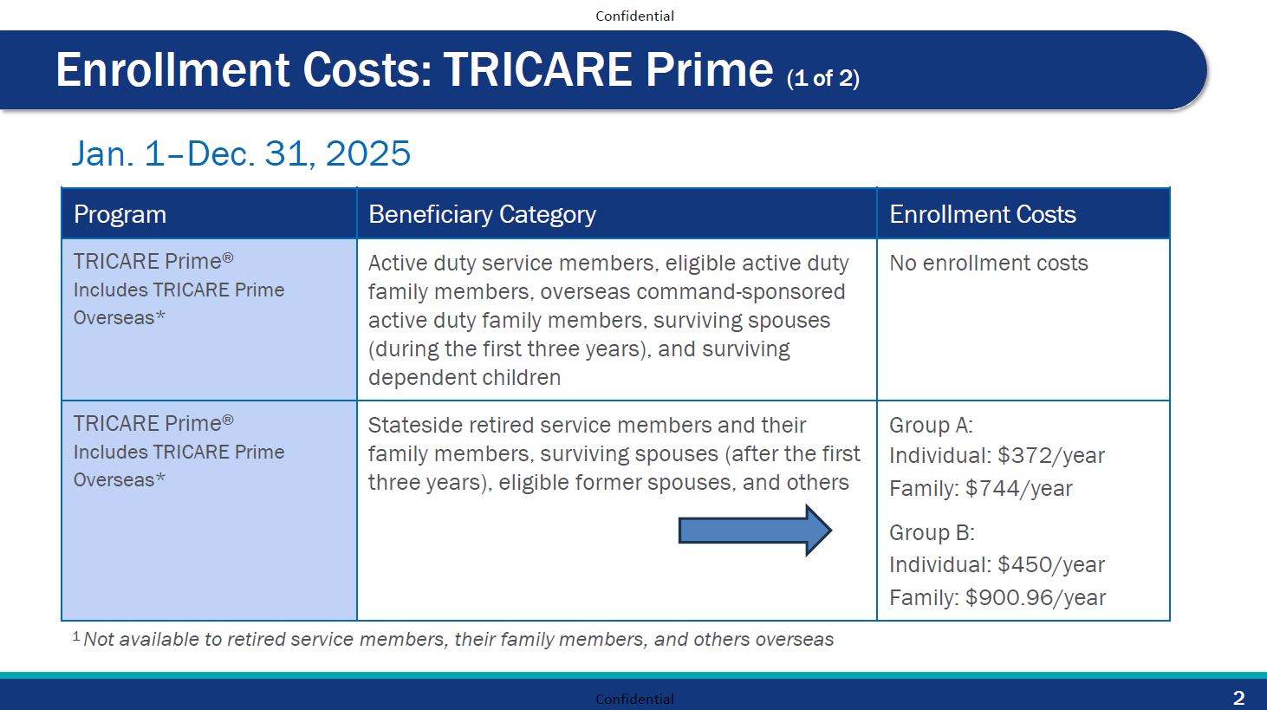
4

Slide 146
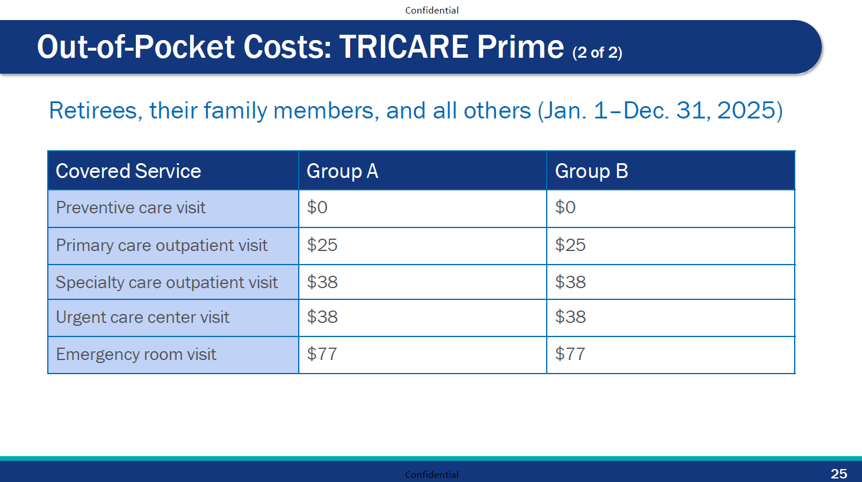

Slide 147
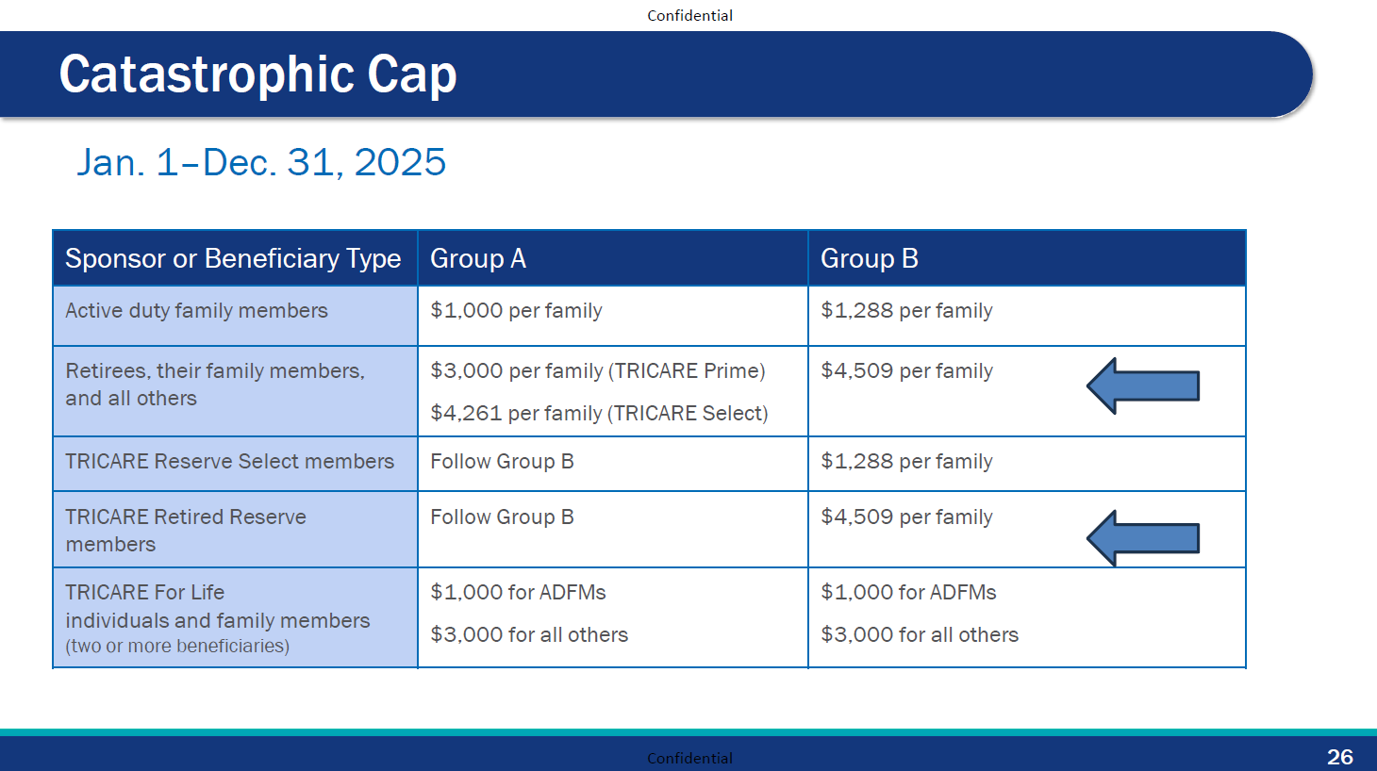

Slide 148
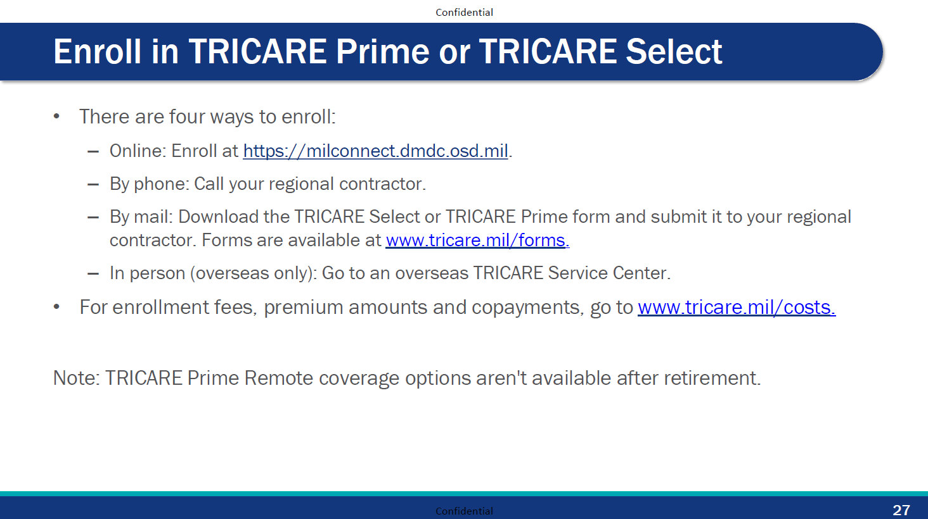

Slide 149
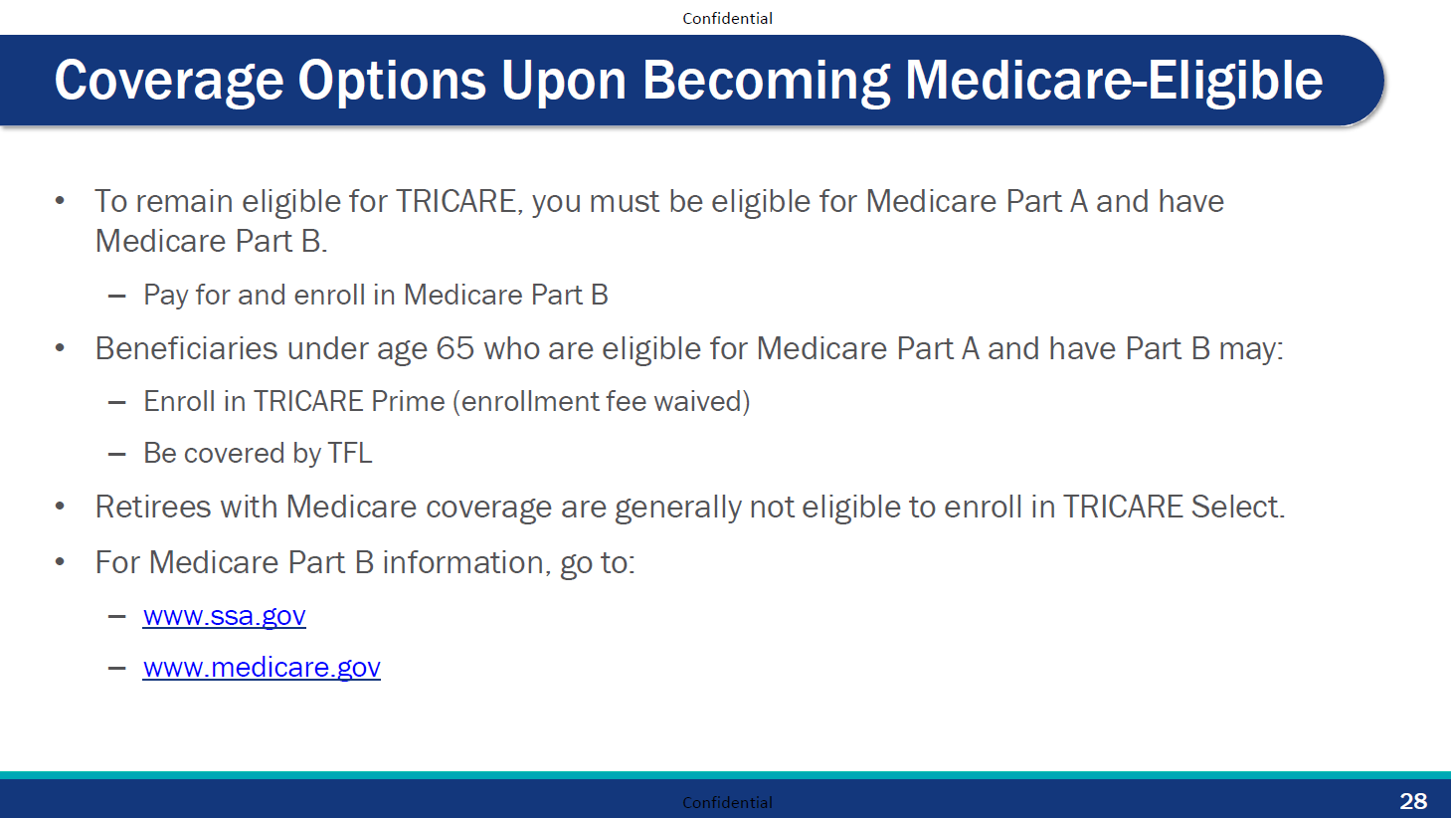

Slide 150
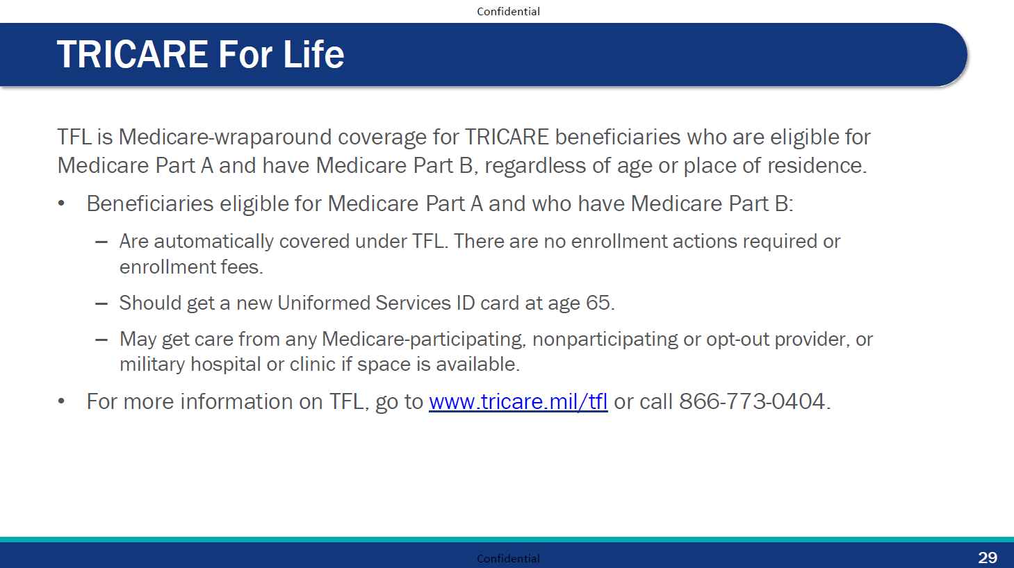

Slide 151
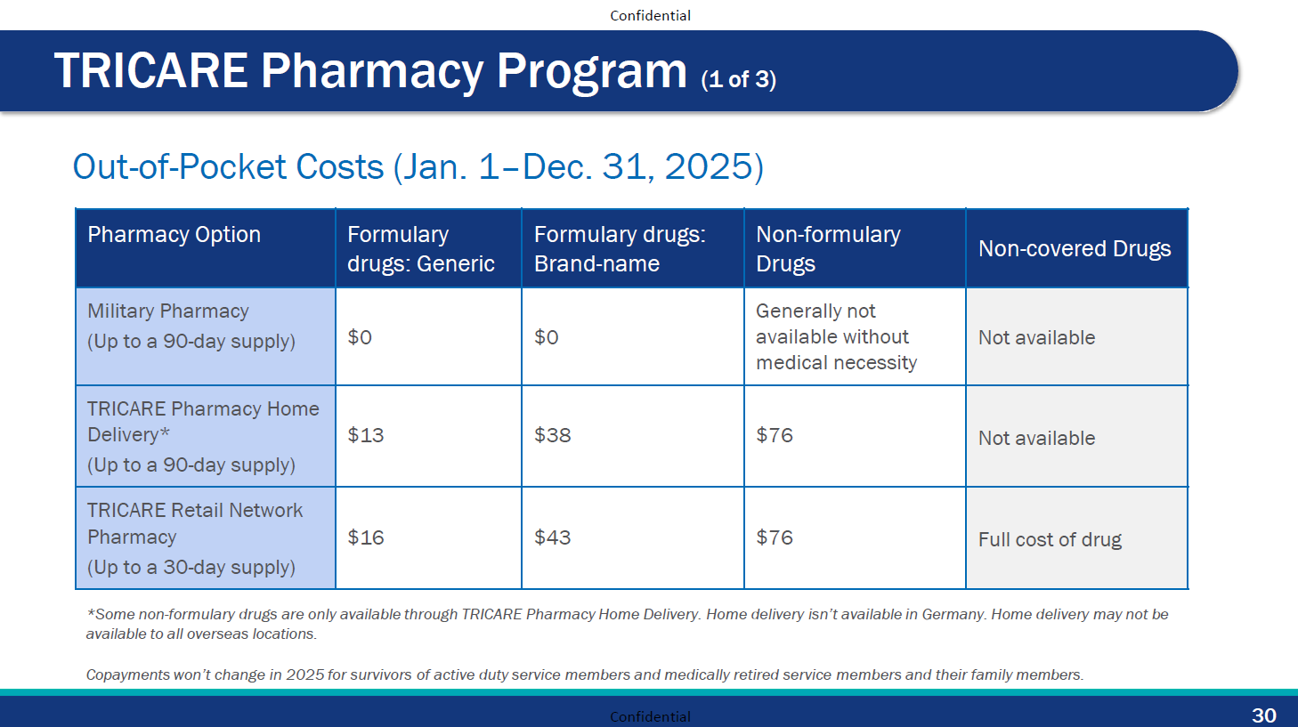

Slide 152
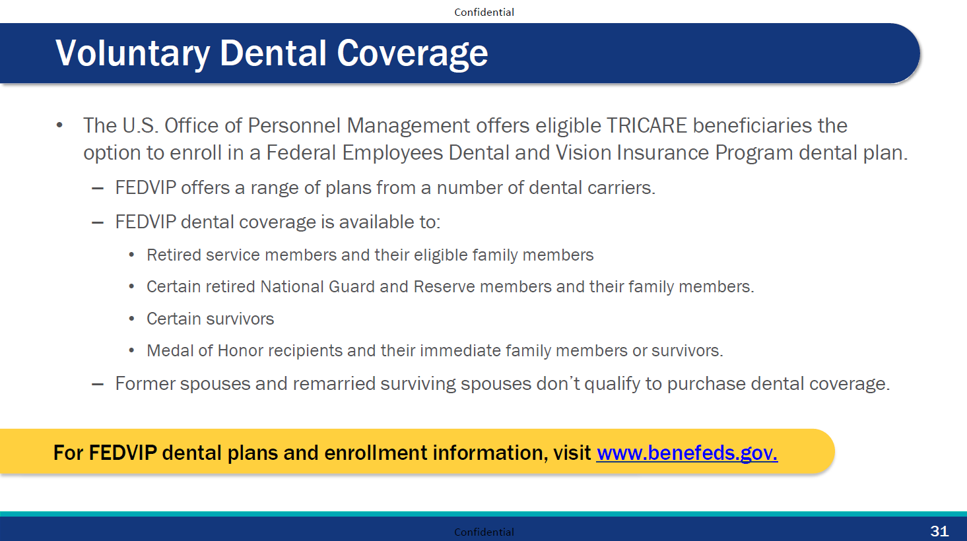

Slide 153
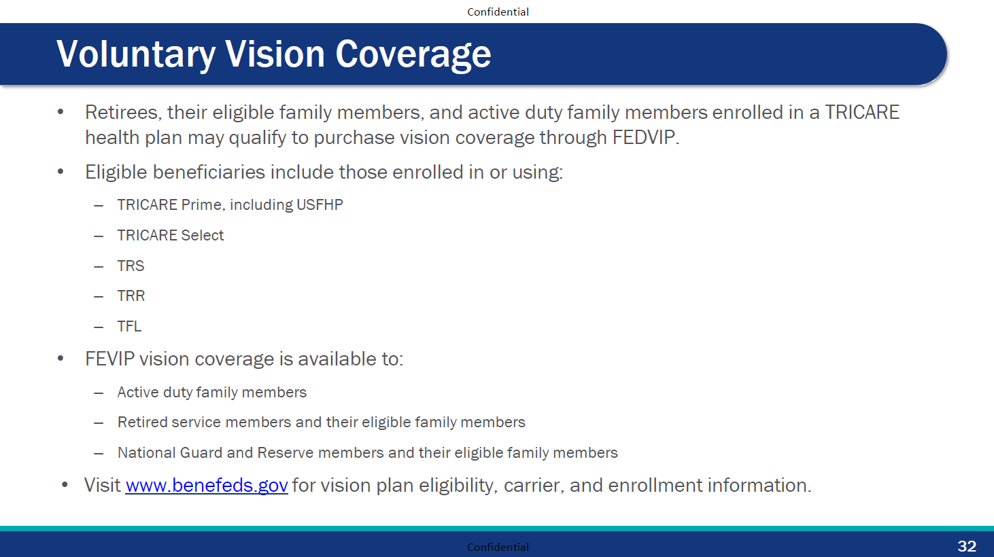

Slide 154
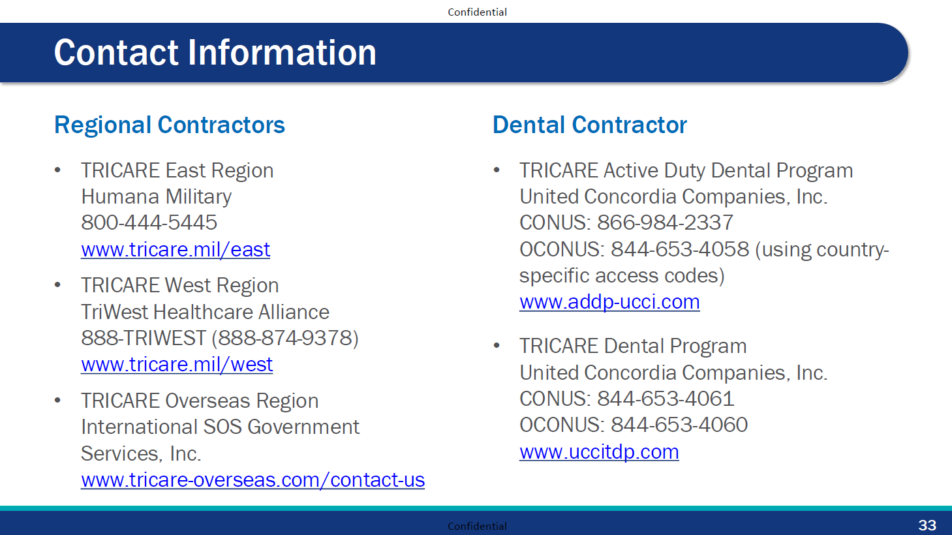

Slide 155
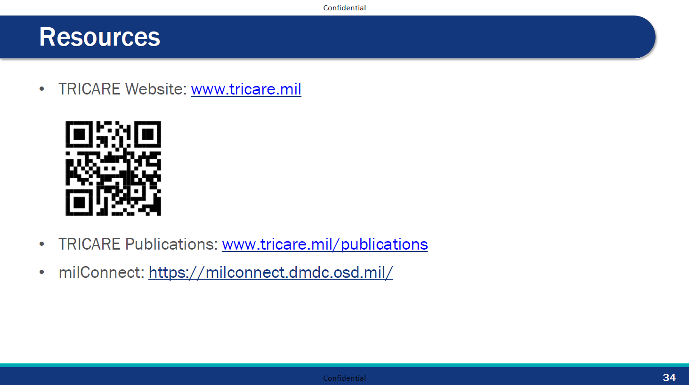

Slide 156


RETIREMENT SERVICES OFFICE
Lyndsay Thrane

Slide 157
HEADQUARTERS DEPARTMENT OF THE ARMY
RETIREMENT SERVICES OFFICE
Army National Guard (ARNG) and United States Army Reserve (USAR) Non-Regular Retirement Planning Seminar
17 JUNE 2025
“BE ALL YOU CAN BE”

Slide 158

Purpose
To provide Soldiers and Family members information on retirement programs, benefits and entitlements.
Retirement is a process NOT an event!!

Slide 159


Iowa National Guard
Retirement Services Office
To provide information on retirement programs, benefits and entitlements to all servicemembers and families. Assist in the processing of requests for retirement and annuitant pay.
  Retirement Pay Processing & Pay Issues
  Survivor Benefit Plan (RCSBP & SBP) Changes
  Annuity & AOP Pay Processing
  AGR Benefits Briefings
  Disability Retirement Pay Processing (CRSC / CRDP)
  Updating Records due to QLE

Slide 160
The Army Retirement Services Program

Slide 161












The Army Retirement Services Website
https://soldierforlife.army.mil/Retirement
Former Spouses

Slide 162

Change of Mission
U.S. Army’s official retirement planning newsletter for Soldiers in all three components with 17+ years of service
Published via myPay SmartDoc in Jan, Apr, Jul and Oct
Sent to 174K Soldiers quarterly. If you didn’t receive it, check your email address in myPay
Available at https://soldierforlife.army.mil/retirement/change-of-mission

Slide 163
Retirement Planning Considerations

Slide 164


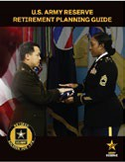


Non-Regular Retirement Process
Priority tasks indicated in red
15-20+ creditable years of service
Ensure your retirement points are correct/manage your retirement points
Attend Retirement Planning Seminar once beginning the MEB/PEB process
17+ years of service
- Gather Resources
18-20 years of service
Attend Mandatory Retirement Planning Seminar
Receive your RCSBP Briefing
Submit a sanctuary packet NLT 120 days before demob/REFRAD if reaching 18 years AFS
9 months prior to Transferring to the Retired Reserve
Apply for transfer to Retired Reserve or Discharge
Reduced Age Eligibility
Final PHA
After 20-year NOE
Check Service obligation
Determine desired retirement date
Plan for medical/dental if applicable
20 years of service
Receive RCSBP Briefing if you haven’t already
Complete the DD Form 2656-5 (within 90 days of receipt of NOE)
30 days prior to transferring to the Retired Reserve (if not already done)
Retirement ceremony
DS Logon
myPay
0-3 months after transferring to the Retired Reserve
New ID cards
TSP
Gray Area
Maintain correct POC information
TRICARE
9 months prior to 60th birthday or Early Age Drop
- Apply for retired pay
Placed on Retired List
New Retired ID Card
Apply for TRICARE
- Apply for TRICARE Retired Reserve, if applicable
Enrollment (if not already done)
For detailed information regarding this timeline, refer to the U.S. Army Reserve Retirement Planning Guide located at https://soldierforlife.army.mil/Retirement/ArmyReserve
Notes:
Presenter Notes
2024-10-03 22:01:12
--------------------------------------------
This is an overview of what a Non-Regular Retirement planning timeline looks like. We developed this timeline to assist when planning for retirement, at your 15-17yrs of service, you should review your retirement points for accuracy and or corrections. Between your 18-20yrs of service, you should be attending a mandatory Retirement Planning Seminar.
It is our job as RSOs to help Soldiers and their Families plan for retirement by giving them the information they need. One way to provide information is to conduct pre-retirement activities, such as briefings and communications for groups. All Retiring Soldiers should attend Retirement Planning Seminars between 18-20 years of service or at least 12 months before their transition. The Retirement Services Office recommends Spouses attend the briefings as well.
Those who think they may receive a medical retirement, attend the closest retirement planning seminar as soon as you enter the Medical Evaluation Board (MEB)/Physical Evaluation Board (PEB) process.
If you know that your mobilization orders will take you over 18 years of active federal service (AFS), you should submit your sanctuary packet no later than 120 days prior to your demobilization date. Sanctuary is a voluntary application request and is not automatic. RC Soldiers are not required to apply for sanctuary; those that do apply and are found qualified, by law, can be retained on active duty until they reach 20 years AFS and become eligible for regular retired pay.
When you attend a Retirement Planning Seminar, you will learn about:
Service member’s Group Life Insurance -- a program to provide low-cost group life insurance to Service Members.
Veteran’s Group Life Insurance -- a program that allows Veterans to convert full-time SGLI coverage to lifetime renewable term insurance.
Combat-related special compensation --Special non-taxable compensation for combat-related disabilities to recover some or all of the retired pay that military Retirees waive for VA disability compensation.
Concurrent retirement and disability pay--Restoration of retired pay for Retirees with service-connected disabilities. It is considered taxable income and is taxed in the same manner as retired pay. Eligible retirees receive CR automatically.
RC Survivor Benefit Plan--A program through which the Department of Defense provides monthly, cost-of-living-adjusted income to eligible Survivors of Soldiers who die on Active Duty, including Reserve Soldiers and National Guard Soldiers who die on Federal Active Duty, and of Retirees who choose to continue participating in the program after they retire. TRICARE--Health care program for Active-Duty Service members, National Guard and Reserve members, Retirees, their Families, Survivors, and certain Former Spouses.
IAW AR 600-8-7, paragraph 7-4, Soldiers wishing to be discharged instead of transferred to the Retired Reserve must be counselled in writing by the first lieutenant colonel in the chain of command to explain the impact on their retired pay and benefits. A Soldier who is eligible to receive retired pay, at age 60, for non-regular service pursuant to chapter 1223 of Title 10, United States Code, but who has been discharged and who maintains no military affiliation is considered a former member. The TRICARE page states that Soldiers must be: “Retired Reserve members who are: Members of the retired Reserve of a Reserve Component who are qualified for non-regular retirement under 10 U.S.C., Chapter 1223 and Under age 60.” (discharged Soldiers/former members are ineligible for TRICARE Retired Reserve) NOTE: At age 60, retired Soldiers and their eligible dependents are entitled to medical care, commissary, exchange, and morale, welfare, and recreation (MWR) privileges. Former members under age 60, and their eligible dependents are entitled to commissary, exchange, and MWR privileges only.
Does anyone have any questions?

Slide 165
Non-Regular (Reserve) Retirement
Retirement eligibility
‒ 20 years of creditable service for a length of service retirement (must have completed a full anniversary year).
‒ 15 years of creditable service and medically disqualified, not as a result of own misconduct.
‒ If you completed 20 years of service before 25 April 2005, you would have a reserve component service requirement.
Retirement Points = Retired Pay: verify yours are correct now! Note: Soldiers must earn a minimum of 50 points per anniversary year ending (AYE) date for a qualifying year.
The MyArmyBenefits retirement calculator is currently being updated to calculate nonregular retired pay and should be available by summer 2025. This calculator automatically pulls retirement points from the Integrated Personnel and Pay System - Army (IPPS-A)! https://myarmybenefits.us.army.mil/NEW-Benefit-Calculators/Retirement-Calculator
Notes:
Presenter Notes
2024-10-03 22:01:12
--------------------------------------------
-Since 25 Apr 05 there is no longer a requirement for serving a mandatory number of years in the RC before being eligible to retire. Prior to that, the 6- or 8-year rule may apply (See Title 10 USC §12731 for additional info)
-Notification of Eligibility (NOE) for non-regular retired pay at age 60, commonly referred to as the 20-year letter, or 15-year letter (in the case of a medical retirement with at least 15 but less than 20 years of creditable service)
-Retirement eligibility age may be reduced based off qualifying periods of active service:
-On or after 29 Jan 08, each day on that AD tour counts toward a reduction in retirement age for Reserve Component Service Members. AD orders that qualify for the reduction in retirement age fall under T10 USC section 12731 and 101(a)(13)(B), and performed under section 688, 12301(a), 12301(d), 12302, 12304, 12304a, 12304b, 12305, 12406, or chapter 13 (insurrection).
-AD under section 12301(h)(1) to receive medical care for the wound, injury, or illness, each day of AD under that order for medical care, shall be treated as a continuation of the original call or order to active duty for purposes of reducing the eligibility age of the member.
-Title 32 section 502(f) is also qualifying service for reduced age eligibility: "Full-time National Guard duty under Section 502(f) for the purpose of responding to either a national emergency declared by the President, or a national emergency supported by Federal funds is qualifying service for reduced age retirement. Note: ASD(M&RA) will designate by authorizing memorandum the full-time National Guard duty that qualifies for reduced age eligibility for receipt of retired pay. ARNG Soldiers should contact their RSO to learn more about specific missions that qualify under 502(f).”
-Days are credited in aggregates of 90 days within a Fiscal Year (see change below). A day of duty shall be included in only one aggregate of 90 days.
-NDAA 2015 allows time to cross into the next fiscal year. However, this is not retroactive so only applies to deployments that started after 30 September 2014.
-Active Guard Reserve (AGR) duty under 12301(d) pursuant to section 12310 of Title 10 USC will not be included as service on active duty for determining eligibility for reduced age retired pay for non-regular service.
-In order to apply for a reduced age retirement, you will need your DD Form 214s and AD orders for the qualifying service.
-The NGB Form 23 (RPAM Statement) and DA Form 5016 (Chronological Statement of Retirement Points): the RPAM/RPAS systems are the systems of record for recording retirement point credit and years of creditable service for retired pay for a non-regular service for USAR and ARNG Soldiers. To earn a qualifying retirement year, you must earn a minimum of 50 retirement points within an anniversary year.
-If you are missing any of the following documents: DA for 5016, 20-Year Letter, DD Form 2656-5 or DD Form 1883, your retirement order, last promotion order, DD Form 214s or AD orders, you can go to the following website and sign into your record using your DS Logon. https//www.hrcapps.army.mil/portal/

Slide 166
Manage Retirement Points
Retirement point statements are crucial in determining retirement eligibility and retired pay.
‒ ARNG Soldiers are issued an updated NGB Form 23A (Army National Guard Current Annual Statement) upon reaching their AYE, which should be reviewed annually with the RPAM Administrator.
‒ USAR Soldiers are issued an updated DA Form 5016 (Retirement Accounting Statement) annually.
Soldiers are responsible for ensuring they earn a minimum of 50 retirement points for each AYE for it to count as a qualifying year.
Retirement point statements should be reviewed for errors. If there are none, no further action is necessary. If errors are identified, the Soldier must provide supporting documentation for correction (i.e., Leave and Earnings Statement, DD Form 214, DD Form 220, retirement point statements from other services, etc.).
Creditable service for retired pay, retirement points, and total career points are summarized in this statement.

Slide 167
Military Retired Pay
and Other Financial Considerations

Slide 168

Calculate Your Retired Pay in 3 Steps
Step 1: Determine your Date of Initial Entry into Military Service (DIEMS).
**This is the date of your initial service contract. This date does not change regardless of breaks in service or changes in duty status.
Step 2: Determine which pay plan you are eligible for based on your DIEMS.
Step 3: Use the appropriate formula to calculate your retired pay (see following slides).
You can find your DIEMS by logging into IPPS-A at https://ipps-a.army.mil/ (CAC only) or by using the mobile app (DS Logon only).
To register for a DS Logon account, go to DMDC Registration
page at https://myaccess.dmdc.osd.mil/identitymanagement/app/login.
For a fast, personalized retired pay calculation, go to the DOD Retirement Calculators at https://militarypay.defense.gov/calculators/, or the MyArmyBenefits page at https://myarmybenefits.us.army.mil/NEW-Benefit-Calculators/Retirement- Calculator (Undergoing updates for RC, available Summer 2025)
Notes:
Presenter Notes
2024-10-03 22:01:16
--------------------------------------------
There are four retired pay plans.
To determine which plan you fall under and how your retired pay will be calculated, complete the following three steps. (Additional detail on each step is provided in subsequent slides.)
Step #1. Determine your date of initial entry into Military service, or DIEMS. Unless you know the definition of DIEMS, you won’t know what yours is, and you won’t be able to determine which retired pay plan you are eligible for. DIEMS is explained on the next slide. Step #2. Determine which pay plan you are eligible for based on your DIEMS. The three pay plans are discussed on the following slides.
Step #3. Use the formula of the appropriate pay plan to calculate your retired pay or just use the retired pay calculator at https://myarmybenefits.us.army.mil/Benefit-Calculators/Retirement. This calculator pulls all your personal data from DEERS to calculate your retired pay on the date you choose.

Slide 169
Retired Pay Plans
Retirement Plan | DIEMS
Final Basic Pay Plan (Years of creditable service (points/360) x 2.5%) x final basic pay | Prior to 8 September 1980
High-36 (AKA High-3) Pay Plan (Years of creditable service (points/360) x 2.5%) x average of highest 36 months of basic pay | Between 8 September 1980 and 31 December 2017
Blended Retirement System (BRS) (Years of creditable service (points/360) x 2.0%) x average of highest 36 months of basic pay | 1 January 2018 or later, or opted-in during the opt-in period (if eligible)
Calculate service time: Total Retirement Points Divided by 360 = Calculated Service
Example: 2560 retirement points divided by 360 = 7.11 (years of
service) or (7 years, 1 month, and 10 days)
Notes:
Presenter Notes
2024-10-03 22:01:17
--------------------------------------------
Credit for all full months served
Final Basic Pay Plan, High-36 Pay Plan and BRS receive Full COLAs
Final Basic Retired Pay Plan: Soldiers with a DIEMS prior to 8 Sep 80 will be retired under the Final Basic Pay Plan (T10 USC 1406) receive retired pay equal to 2.5% (called the “percentage multiplier”) of their final basic pay for each full year of creditable service, and 1 1/12th of 2.5% for each full month. Because these Soldiers receive a percentage of their FINAL month’s basic pay, they should avoid retiring just before reaching a basic pay milestone such as over-22 years, over 24 years, over-26 years, over-30 years, over-34 years or over-38 years.
High-36 (High-3) Retired Pay Plan: Soldiers with a DIEMS between 8 Sep 80 and 31 Dec 17 will be retired under the High-3 (High-36) Retired Pay Plan (T10 USC 1407). Those with DIEMS dates from 1 Aug 86 to 31 Dec 17 remain enrolled in the High-3 Plan unless they opted to switch to the CSB/REDUX pay plan in conjunction with reaching their 15th year of active service (see below). The percentage multiplier for Soldiers under the High-3 Plan is the same as that for the Final Basic Pay Plan (2-1/2%), but it is multiplied by the “average of the highest 36 months of basic pay” rather than by the “final basic pay.” The “average of the highest 36 months of basic pay” will typically be the Soldier’s last 3 years of basic pay. The Blended Retirement System:
TSP: The Blended Retirement System includes a TSP component.
All Service members joining after January 2018, will be automatically enrolled into the TSP at 3% of their base pay, with automatic 1% DOD contributions starting after 60 days, and DOD matching up to 4% at the start of the third year of service. Both the DOD automatic 1% and the matching contributions continue through the end of the pay period during which the Service member attains 26 years of service.
NOTE: Service members who opted-in to the Blended Retirement System between January 1, 2018, and December 31, 2018 received DOD automatic 1% contribution and up to 4% additional DOD matching beginning the first pay period of election. MONTHLY RETIRED PAY: For those who retire after at least 20 years of service, the retirement remains predominantly a defined benefit in which the Service member will get monthly retired pay.
Instead of being calculated at 2.5 percent times the average of the Service member’s highest 3 years of basic pay, the Service member’s monthly retired pay will be calculated with a 2.0 percent multiplier. LUMP SUM: The lump-sum option gives Service members choices at retirement.
The lump-sum option allows Service members to choose to elect 25% or 50% lump-sum payment at retirement in exchange for reduced monthly retired pay until the Service member reaches full Social Security retirement age, which for most is 67 years old. The DOD published guidance related to this provision of the Blended Retirement System.
CONTINUATION PAY: The National Defense Authorization Act of Fiscal Year 2016 also included a continuation pay provision as a way to encourage Service members to continue serving in the Uniformed Services. Continuation Pay is a direct cash payout, like a bonus.
It is targeted at the mid-career mark, between the 7th and 12th year of service. The DOD publishes guidance related to this provision.

Slide 170
Final Pay Plan Calculation Example
Total Pts for Ret Pay
360
X 2.5% X final basic pay = Retired Pay
DIEMS: 19790731
Service for Retirement: Total Points 2,846 = 7.91 years*
Calculation: 7.91 x 2.5% x $8,073.90 = $1,596
Monthly Retired Pay: $1,596
SBP Monthly Premium: $1,596 x 6.5% = $103
RCSBP Monthly Premium: $1,596 x 3.5%** = $55
Monthly Taxable Retired Pay: $1,596 - $158 = $1,438
SBP Monthly Annuity: $1,596 x 55% = $877
*Years of service are computed by dividing total creditable points by 360
**RCSBP Monthly Premium percentage is dependent on age of Soldier at NOE, age of beneficiary at NOE, and age at non-regular retirement. Use the SBP Premium Calculator for your specific estimate
https://myarmybenefits.us.army.mil/Benefit-Calculators/SBP-Premium-Calculator

Slide 171
High-36 Pay Plan Calculation Example
Total Pts for Ret Pay
360
X 2.5% X highest 36 months of basic pay = Retired Pay
DIEMS: 19850731
Service for Retirement: Total Points 2,846 = 7.91 yrs*
Calculation: 7.91 x 2.5% x $7,817 = $1,545
Monthly Retired Pay: $1,545
SBP Monthly Premium: $1,545 x 6.5% = $100
RCSBP Monthly Premium: $1,545 x 3.5%** = $54
Monthly Taxable Retired Pay: $1,545 - $154 = $1,391
SBP Monthly Annuity: $1,545 x 55% = $849
*Years of service are computed by dividing total creditable points by 360
**RCSBP Monthly Premium percentage is dependent on age of Soldier at NOE, age of beneficiary at NOE, and age at non-regular retirement. Use the SBP Premium Calculator for your specific estimate https://myarmybenefits.us.army.mil/Benefit-Calculators/SBP-Premium-Calculator

Slide 172






Blended Retirement System (BRS)
Defined Benefit For non-regular retirement, at age 60 or earlier with creditable active service
Basic qualifications for retirement do not change
The pension is still the primary component of military retirement
Total Pts for Ret Pay
X 2% X highest 36 months of basic pay = Retired Pay
360
Defined Contribution
Individual Contribution | Agency Automatic Contribution | Agency Matching Contribution | Total TSP Monthly Contribution
0% | 1% | 0% | 1%
1% | 1% | 1% | 3%
2% | 1% | 2% | 5%
3% | 1% | 3% | 7%
4% | 1% | 3.5% | 8.5%
5% | 1% | 4% | 10%
NOTE: Currently serving members who opted-in will see matching contributions immediately
Continuation Pay
Lump Sum
Mid-career incentive designed to maintain force retention
Payable between 7 and 12 years of service*
AC: 2.5 x monthly basic pay (2.5 x or 4 x for RC)*
*As determined by the Service Secretaries each calendar year
At retirement, may elect lump sum of 25% or 50% of retired pay from retirement to age 67
At age 67, retired pay reverts to full annuity
Notes:
Presenter Notes
2024-10-03 22:01:18
--------------------------------------------
• Let’s take a more detail look at the new Blended Retirement System.
• TSP: The Blended Retirement System includes a TSP component.
• All Service members joining after January 2018, will be automatically enrolled into the TSP at 3% of their base pay, with automatic 1% DoD contributions starting after 60 days, and DoD matching up to 4% at the start of the third year of service.
• Both the DoD automatic 1% and the matching contributions continue through the end of the pay period during which the Service member attains 26 years of service.
• NOTE: Current Service members who opt-in to the new Blended Retirement System between January 1, 2018, and December 31, 2018 (we’ll talk about opting-in in a moment) will receive DoD automatic 1% contribution and up to 4% additional DoD matching beginning the first pay period of election.
• MONTHLY RETIRED PAY: For those who retire after at least 20 years of active service, the retirement remains predominantly a defined benefit in which the Service member will get monthly retired pay. I
• Instead of being calculated at 2.5 percent times the average of the Service member’s highest 3 years of basic pay, the Service member’s monthly retired pay will be calculated with a 2.0 percent multiplier.
• LUMP SUM: The lump-sum option gives Service members choices at retirement.
• The lump-sum option allows Service members to choose to elect 25% or 50% lump-sum payment at retirement in exchange for reduced monthly retired pay until the Service member reaches full Social Security retirement age, which for most is 67 years old.
• The DoD continues to work on guidance related to this provision of the Blended Retirement System.
• CONTINUATION PAY: The National Defense Authorization Act of Fiscal Year 2016 also included a continuation pay provision as a way to encourage Service members to continue serving in the Uniformed Services.
• Continuation Pay is a direct cash payout, like a bonus.
• It is targeted at the mid-career mark, at the 12th year of service.
• The DoD continues to work on guidance related to this provision.
Members of the Individual Ready Reserve (IRR) are also eligible to participate in the Blended Retirement System, but in order to elect to enroll into the Blended Retirement System they must be receiving pay (because of the Thrift Savings Plan component). Therefore, members of the IRR who are eligible to enroll in the Blended Retirement System (because they are in the IRR as of December 31, 2017), but who do not drill in a paid status at all during calendar year 2018, will be allowed a one-time extension of the enrollment window beyond 2018. Not eligible for BRS:
Retired Reserve Inactive National Guard Inactive Standby List

Slide 173

High-36/BRS Comparison
 | High-36 | BRS
Dates | Thru: 31 December 2017 | Starts: 1 January 2018 Opt In: 1 January to 31 December 2018
Pay Formula | Yrs & mos of service x 2.5% x avg of 36 highest months of basic pay | Yrs & mos of service x 2.0% x avg of 36 highest months basic pay
% at 10 YOS (3,600 points) | 25% | 20%
% at 15 YOS (5,400 points) | 37.5% | 30%
% at 20 YOS (7,500 points) | 50% | 40%
TSP | Yes, but no matching | Yes, with matching
Continuation Pay | No | Yes
Lump Sum at Retirement | No | Yes (25% or 50% with full annuity at age 67)
Key websites:
DOD Uniformed Services BRS http://militarypay.defense.gov/BlendedRetirement/ USAR BRS
http://www.usar.army.mil/Retirement/ ARNG BRS
https://www.milsuite.mil/book/groups/arng-hrp-t-retirement-services/pages/retirement-services

Slide 174
Reduced Age Eligibility
Eligibility age reduced below age 60, in 90-day increments, for qualifying periods of active duty (AD) service within a fiscal year on or after 29 January 2008. On or after 1 October 2014, 90-day increments CAN cross fiscal year boundaries (not retroactive).
AD for this purpose means service pursuant to a call or order to AD on orders specifying and performed under Title 10 United States Code (USC) sections 688, 12301(a), 12301(d), 12302, 12304, 12304a, 12304b, 12305, 12406, and chapter
13 (insurrection). In addition, service under a call to active service authorized by the President or the Secretary of Defense under 32 USC section 502(f) for purposes of responding to a national emergency declared by the President or supported by Federal funds.
If a Soldier is wounded, injured, or ill while serving on AD while serving under a provision of law mentioned above, and then ordered to AD pursuant to section 12301(h)(1) to receive medical care for the wound, injury, or illness, each day of AD under that order is qualifying service towards reduced age eligibility.
Service on Active Guard/Reserve (AGR) duty pursuant to T10 section 12310 will not be included as service on active duty for determining eligibility for reduced age retired pay for non-regular service.
Notes:
Presenter Notes
2024-10-03 22:01:19
--------------------------------------------
Every 90 aggregate days performed will reduce age by 90 days
Does not need to be consecutive
Active-Duty time served on or after 29 Jan 08
Must be within the same fiscal year until 1 Oct 14
As of 1 Oct 14 can cross the fiscal year boundaries
Authorities include: Title 10 USC 688, 12301(a), 12302, 12304, 12304a, 12304b, 12305, 12406 and chapter 13 (insurrection), and Title 32 USC 502(f). Also 12301(h)(1)-medical
NOTE: when you are under RAR, you will not be covered by TRICARE.
ASD(M&RA) will designate by authorizing memorandum the full-time National Guard duty (FTNGD) that qualifies for reduced age eligibility for receipt of retired pay. ARNG Soldiers should contact their RSO to learn more about specific missions that qualify under 502(f).

Slide 175
Complete Non-Regular Retired Pay Application
The Gray Area Retirements (GAR) Branch mails postcards to eligible Retired Reserve Soldiers when they turn age 59 to notify them that they are eligible to apply for retirement. Soldiers may request a retirement application by contacting HRC or by downloading it from https://www.hrc.army.mil/content/Gray%20Area%20Retirements%20Branch.
Submit no earlier than 9 months and no later than 90 days prior to retirement date (Age 60 or reduced age eligibility) to ensure payment in a timely manner
The application packet consists of a DD Form 108 (Application for Retired Pay Benefits), a DD Form 2656 (Data for Payment of Retired Personnel), retirement point statement, NOE, etc. (see website at link above for all required documents).
Methods for submitting the completed application are:
‒ Email: usarmy.knox.hrc.mbx.tagd-ask-hrc@army.mil (preferred method)
‒ Mail:
Department of the Army
US Army Human Resources Command ATTN: AHRC-RPS-GAR
1600 Spearhead Division Avenue Dept. 482 Ft. Knox, KY 40122-5402
Notes:
Presenter Notes
2024-10-03 22:01:19
--------------------------------------------
Contact the RSO office in your state/RD for assistance with completing the Retirement Pay Application.
It is important that Retired Soldiers maintain current contact information with HRC while in the Gray Area to ensure they receive the postcard and any other important information
If eligible for reduced age retirement, adjust the application submission timeline based on the qualifying time for early retirement. Applications with qualifying service for reduced age retirement should be labeled with EARLY RETIREMENT -or - EARLY AGE DROP on the top of the application.

Slide 176

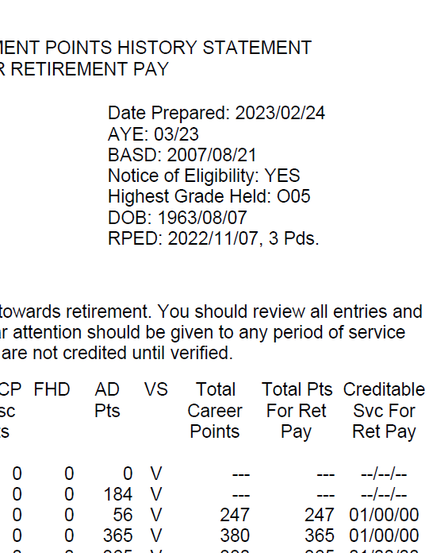
Applying for Retired Pay
with the Iowa RSO Office
Contact the Iowa National Guard Retirement Services Office at Camp Dodge 12 months prior to your RPED date to set up an appointment.
During your appointment with the RSO – retired pay packet gets completed and you will receive a benefit briefing for information about your next steps and upcoming benefits and entitlements.
Important Retirement Documents:
NOE – 20 or 15 year letter & RCSBP Election (DD 2656-5)
Final RPAM – NGB23C
DD 214(s) & Mob Orders
Documents to support Life Changes – marriage, divorce, death, birth, etc.

Slide 177

Retired Pay Facts
Retired pay is paid by DFAS-Cleveland
Payable on the 1st of the month (when the 1st falls on a weekend or holiday, the pay date is moved to the previous business day)
Use myPay to make online changes to pay, reissue 1099Rs, change bank accounts, change email or mailing addresses, change tax withholding, manage allotments, etc.
Keep correspondence and email addresses current
Monthly electronic Retiree Account Statements (eRAS) are available in your myPay account
https://mypay.dfas.mil/
Notes:
Presenter Notes
2024-10-03 22:01:19
--------------------------------------------
The Defense Finance and Accounting Service’s Cleveland Center (DFAS-CL) pays military retired pay for ALL uniformed services Retired Soldiers and annuitants (except the Public Health Service).
You are required to use Electronic Funds Transfer (EFT) (also called direct deposit) to a financial institution for your military retired pay. If your pay will continue to the same financial institution that you used on active duty, a new direct deposit form is not required; the DD Form 2656, Data for Retired Pay, will suffice. Changes to a financial institution after retirement require either an SF 1199A (Direct Deposit Form) or an FMS 2231 (Fast Start Direct Deposit Form). Retired Soldiers sometimes fail to notify DFAS-CL of a change to their home mailing (correspondence) address. Please be sure and change your correspondence and email with DFAS-CL so that address can be used in the mailing of important documents such as pay statements, tax forms, Army Echoes, and installation retiree newsletters.
DFAS-Cleveland’s mailing address is: Defense Finance and Accounting Service, US Military Retired Pay, 8899 E 56th Street, Indianapolis IN 46249-1200. The DFAS customer service toll-free number is 1-800-321-1080; their website is: https://www.dfas.mil/. This information is provided in every issue of Army Echoes. We encourage the use of the online pay system called myPay: https://myPay.dfas.mil NOTE: The PIN you use in the myPay system as an active-duty member can be carried into retirement.
myPay allows you to change your federal and state withholding taxes and exemption status; stop, start, or change allotments; change your correspondence address; update your financial institution EFT information; request a replacement IRS Form 1099R; and start, stop and change bonds. You can even opt to “turn off” hard-copy mailing of your annual Retiree Account Statement. Your Retirement Services Officer (RSO) has access to the Retired Pay database and can assist you in making any pay changes if you’re unable to accomplish them through myPay or via contact with Cleveland.

Slide 178
Gray Area Future Retiree myPay Account
How to Access a Gray Area Future Retiree myPay Account:
If you set up a Login ID and password in myPay prior to your transition:
You may be able to use the myPay login you created prior to your retirement if you previously set up a Login ID and password, and you remember the answers to your security questions (and if retired after 2021, have access to the Two-Factor Authentication method you chose).
If you do not remember your password, or it has expired, you can reset your myPay password online by correctly replying to 3 of the 8 security questions you set up, after clicking on the “Forgot or Need a Password” link on the myPay home page.
If you’ve never used myPay, or it’s been several years, or you did not set up a Login ID and password in myPay prior to your transition, here’s how to get started:
Go to the myPay homepage at https://mypay.dfas.mil and click on the “Forgot or Need a Password?” link. Follow the instructions to have a temporary password mailed to you. If you don’t receive the mailed password, it is likely DFAS doesn’t have a current mailing address for you.
Notes:
Presenter Notes
2024-10-03 22:01:19
--------------------------------------------
How to update MyPay: https://www.dfas.mil/militaryseparations/HowtoupdatemyPay/
New to MyPay? How to Get Started: https://www.dfas.mil/Portals/98/Documents/RetiredMilitary/myPay%20Get%20Started%20RA%20June%202022.pdf?ver=Pv3zdmFtu0Y3v-HLIywcTA%3D%3D#:~:text=If%20you%27ve%20never%20used,in%20about%2010%20business%20days

Slide 179
Gray Area Future Retiree myPay Account (Cont’d)
You can locate a Trusted Agent in your area that can provide an in- person password reset. To see the list, go to the myPay homepage and click on “Contact Us” at the top of the page, then click on the “Trusted Agent” link under “In Person” OR call the myPay Customer Support Unit Toll-Free at 888-332-7411 or 317-212-0550 for additional assistance. Identify yourself as a Gray Area Retiree.
If you try to log in and receive a message saying that you don’t have an account, or you are told you aren’t on the future retiree list:
Call the DFAS Retired & Annuitant Pay Customer Care Center at 800- 321-1080 and tell them you are a Gray Area Retiree and don’t have a myPay Account. Ask them to notify the Retired & Annuitant Pay Gray Area Team. Provide your full name, social security number, the year you transitioned to the Gray Area, and your contact information. DFAS will let you know when they have resolved the issue so you can log in.
For additional information, go to: https://www.dfas.mil/RetiredMilitary/plan/Gray-Area-Retirees/

Slide 180
Retired Uniformed Services Identification Card (USID), and DS Logon Information

Slide 181
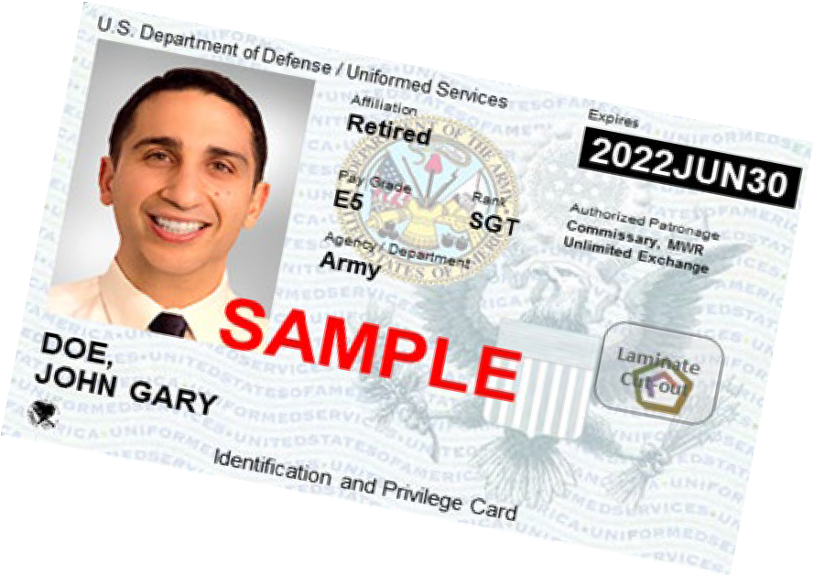
Impact of ID Card Changes at Retirement
Soldier turns in Common Access Card (CAC)
The Retired Uniformed Services ID (USID) card is not a CAC, so…
‒ No access to DOD Enterprise Email
‒ No access to CAC-enabled systems
‒ Must change myPay account to commercial email
‒ Must obtain DS Logon Account to access records and systems
DOD has transitioned to the issuance of a more secure next generation USID to replace the former paper-based USID. Although the new USID looks like a CAC, it does not contain a chip. For more information go to https://www.cac.mil/Next-Generation-Uniformed-Services-ID-Card/
DS Logon: Request an account online at https://www.dmdc.osd.mil/identitymanagement or visit an ID Card facility or VA Regional Office

Slide 182

Websites Accepting DS Logon
Army Review Board Agency (ARBA) Case Tracking System (ACTS)
Army Transition Assistance Program (Army-TAP) Portal
ArmyFit - U.S. Army Resilience Directorate (ARD)
Beneficiary Web Enrollment (BWE)
Consolidated ID Card Office Online
U.S. Army Human Resources Command (HRC) - interactive Personnel
Electronic Records Management System (iPERMS)
Integrated Personnel Pay System - Army (IPPS-A)
milConnect
Military Health System GENESIS Patient Portal (MY MHS GENESIS)
Military Information Platform (MIP)
Military OneSource
Remote Order Entry System - (ROES)
TRICARE Online (TOL) (website and mobile app)
U.S. Department of Veterans Affairs (VA) and eBenefits

Slide 183
Staying Connected,
and Additional Information and Resources

Slide 184

How to Update your contact information in IPPS-A
Log into your account in IPPS-A at https://ipps-a.army.mil/ using your CAC or DS Logon
Once logged in, click on the navigation bar symbol on the top right of the page, then select “menu”
This will open the personal information section where you can update or add:
‒ Your work and/or home mailing addresses
‒ Your contact phone numbers to include work, home, mobile, and next of kin

Slide 185




MyArmyBenefits
Benefit Calculators
Benefit Library
Help
Federal Fact Sheets
State and Territory Benefits Fact Sheets
Resource Locators
Benefit Calculators
Desk
Benefit Library
Retirement
Survivor Benefits
Deployment Calculator
Online Survivor Benefits Reports (OSBR)
Survivor Benefits Reports
Benefits Help Desk Operations
https://myarmybenefits.us.army.mil

Slide 186
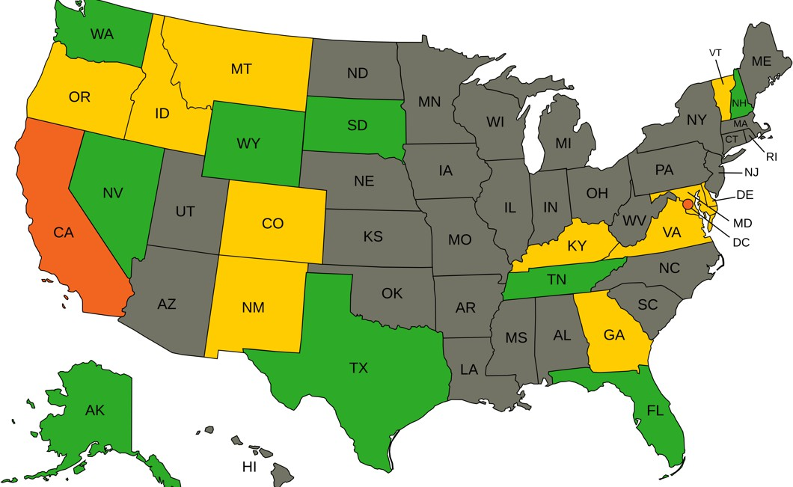

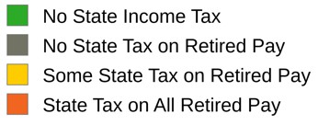
Taxes*
Federal taxes are due on all retired military compensation
Home of Residence is the determining factor; not Home of Record!
Note: The Military Spouses Residency Relief Act (MSRRA)
allows spouses of military personnel to declare the same state of legal residency as their spouse for state tax purposes
You pay NO Social Security or Medicare tax on retired pay. You’ll collect full Social Security benefits when you reach the age of eligibility!
*State taxes as of 30 January 2025. Conditions or limitations apply. Check state law. See the MyArmyBenefits state fact sheets at https://myarmybenefits.us.army.mil/Benefit-Library/State/Territory-Benefits for details.

Slide 187


Army Echoes
Retired
The Army’s official newsletter for Soldiers
Delivered electronically to your email address in myPay
Change your email address in myPay to a commercial email address before you retire!
iPhone & Android phone apps
Read the Army Echoes Blog to receive frequent news between editions at https://soldierforlife.army.mil/retirement/blog

Slide 188

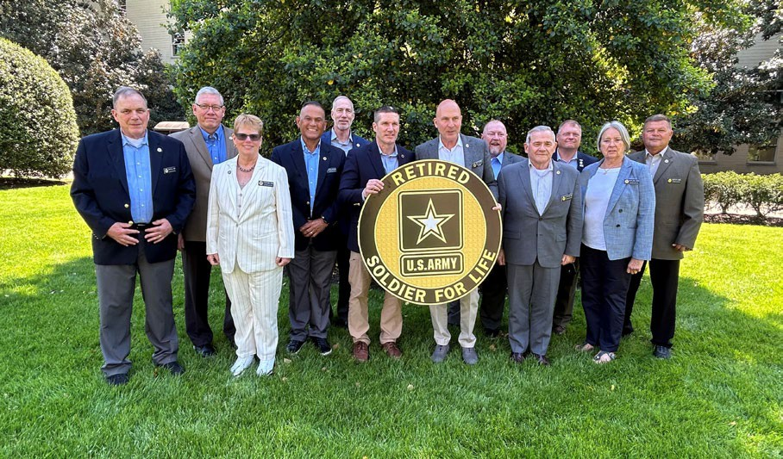
Retired Soldier Motto:
“Your mission has changed, but your duty has not”
Opportunities to Still Serve include:
‒ JROTC Instructor http://www.usarmyjrotc.com
‒ Military service organizations
‒ Veterans service organizations
‒ Retiree Recall https://www.hrc.army.mil/content/Retiree%20Recall
‒ Installation volunteer positions https://www.armymwr.com/programs-and- services/personal-assistance/volunteer-corps
Talk to your retirement services officer about joining:
‒ Installation Retiree Councils
‒ CSA Retired Soldier Council
Retired Soldier Council reports available at: https://soldierforlife.army.mil/retirement/csa-retired-soldier-council
Notes:
Presenter Notes
2024-10-03 22:01:29
--------------------------------------------
Many Retired Soldiers continue to LIVE the Army retiree motto --“Once a Soldier, always a Soldier…a Soldier for Life” If interested in learning of ways to continue serving, contact your nearest installation Retirement Services Officer (RSO). Perhaps service on their installation Retiree Council appeals to you.
We’d like you to consider it now in light of what you might like to do after retirement.
One of the duties of an installation Retiree Council is to formulate issues annually to “send up” to the Chief of Staff, Army Retired Soldier Council for their deliberation and possible briefing to the Chief. The 14-member CSA Retired Soldier Council serves Retired Soldiers worldwide and is comprised of seven officers and seven enlisted members. They serve at the approval of the CSA for 4-year terms.

Slide 189
Where Do You Find Retirement Information?
Army G-1 Retirement Services Office Homepage https://soldierforlife.army.mil/Retirement
  DA Retirement Planning Guide
  USAR & ARNG Non-Regular Retirement Guides
  DA Survivor Benefit Plan (SBP) Briefing
MyArmyBenefits at https://myarmybenefits.us.army.mil/
Army Installation Retirement Services Officers (RSOs) https://soldierforlife.army.mil/Retirement/contact-us
HRC Gray Area Retirements Branch https://www.hrc.army.mil/content/Gray%20Area%20Retirements%20Branch
USAR Readiness Division RSOs listed at: https://soldierforlife.army.mil/Retirement/ArmyReserve
State RSOs can assist National Guard Soldiers https://myarmybenefits.us.army.mil/Benefit-Library/Resource-Locator
SBP vs. Life Insurance Comparison tool
https://actuary.defense.gov/Survivor-Benefit-Plans/

Slide 190











https://soldierforlife.army.mil/Retirement
https://www.dvidshub.net/unit/HQDA-RSO
@USArmySoldierForLife
@USArmySoldierForLife
@USArmySFL
@USArmySFL
@USArmySFL
@USArmySFL
https://soldierforlife.army.mil/Retirement/change-of-mission
https://soldierforlife.army.mil/Retirement/army-echoes https://soldierforlife.army.mil/Retirement/blog
Join the conversation
70

Slide 191
Additional Benefits Information

Slide 192


Veterans Inquiry Branch - The Veterans S1
Name/gender/SSN change requests
Personnel records maintenance/ updates, and copy requests
DD Form 214/215 Requests
Retirement Point Statements requests
Contact:
Phone: 888-276-9472, 0800-1800
EST Monday-Friday
Email: usarmy.knox.hrc.mbx.tagd- ask-hrc@army.mil
Notes:
Presenter Notes
2024-10-03 22:01:31
--------------------------------------------
Contact:
Phone: 888-276-9472, 0800-1800 EST Monday-Friday Email: usarmy.knox.hrc.mbx.tagd-ask-hrc@army.mil Mail: U.S. Army Human Resources Command
ATTN: AHRC-PDR-H
1600 Spearhead Division Avenue, Dept. 420 Ft. Knox, KY 40122-5402

Slide 193


Space-Available Travel
Retired Soldiers may travel within CONUS or OCONUS.
All travelers remain on the Space-A list for 60 days after registration, for the duration of their travel authorization, or until they are selected for travel.
Eligible travelers can sign up for the Space-A list online at https://www.amc.af.mil/AMC-Travel-Site/AMC-Space-Available-Travel- Page/Space-Available-Email-Sign-up-Form/ or by completing AMC Form 140 and bringing (or faxing) it to the nearest AMC Passenger Terminal.
Benefit ends for Family members with death of the Retired Soldier. https://www.amc.af.mil/AMC-Travel-Site/AMC-Space-Available-Travel-Page/
Notes:
Presenter Notes
2024-10-03 22:01:31
--------------------------------------------
Oftentimes, Military flights throughout the world have vacant seats. Active and Retired Soldiers and their eligible family members who are traveling unofficially may fill those seats on a space-available (Space-A) basis. The Retired Soldier and Family member have a lower priority than the active duty Soldier. Since eligible family members must be accompanied by the sponsor, the Space-A travel benefit ends for Family members when the Retired Soldier dies.
You no longer need to wait AT an air terminal for the next vacant flight. You may FAX your request in and stay on the list for up to 60 days. During that time, you may decline any available flights without your name being removed from the list. Books on Space-A travel are available for purchase through the Army & Air Force Exchange System.

Slide 194







Your Exchange Benefits in Retirement
“We’re honored to serve those who have served.”
Online
Sign up for alerts
and discounts
On Your Phone
Get great money saving offers!
And at
your local Exchange and Express!
Tri-weekly coupons by text
Name brand discounts (10%+)
Weekly Facebook discounts (https://www.facebook.com/shopmyexchange)
eNewsletter online discounts
Buddy list specials/local events
Notes:
Presenter Notes
2024-10-03 22:01:31
--------------------------------------------
We’ve improved our online information for our Retired Military family. Go to shopmyexchange.com and click on “Community”. You’ll find a wealth of information on the military community and resources specific to Retired Soldiers. There’s even a Retiree Corner link that will take you to a collection of memorabilia and items that are of interest to Retired Soldiers. Online - Facebook – We feature coupons that you can use in-store or online. For use in-store, just print out the coupon from the Facebook AAFES BX/PX “coupons” tab on the left side of the page. To use a coupon online, enter the coupon code during the checkout process. To get to our Facebook page, just type www.facebook.com/AAFES.BX.PX.
Each year, the Exchange salutes your service with a special three-day event.
Benefits information flyer will be direct mailed to approximately 820,000 Army and Air Force Retired Soldiers in CONUS. OCONUS locations will receive flyers sent directly to their stores. The celebration will include those retired and still serving and invite them to participate in locally planned store activities and take part in exceptional sales events to celebrate those who have served and are still! Save 5 cents off every gallon at Express Fuel Stations when you pay with your MILITARY STAR card. Available every day, 365 days a year. Periodic fuel promotions allow you to save more than 5 cents per gallon. Previous promotions were 10 cents off per gallon or more.
Our customers are mobile, and so are we! Download the Exchange app on your mobile device for instant access to Exchange information. Get Gift Card Balances
Find Exchange Store Locations Shop the mobile Exchange
Access Community Information such as Public Affairs, Vendor Relations and More.

Slide 195

Army Emergency Relief
Helping the Army take care of its own since 1942
Did you know…
AER’s sole mission is to provide emergency financial assistance to relieve the distress of Army personnel, Retired Soldiers, and their families.
As a Retired Soldier, you are eligible for all categories of assistance, and you may continue to contribute through an allotment from your retired pay.
Also, awards scholarships to spouses and children of Retired Soldiers.
For assistance, contact the AER section on your nearest Army installation, other service aid societies or the American Red Cross.
You can continue taking care of Soldiers who are still currently serving as well as fellow Retired Soldiers by setting up an allotment from your retired pay or by making an annual donation to AER.
More information available at https://www.armyemergencyrelief.org/
Notes:
Presenter Notes
2024-10-03 22:01:32
--------------------------------------------
AER is a private nonprofit organization incorporated in 1942 by the Secretary of War and the Army Chief of Staff.
Assistance includes no-interest loans and grants for emergency travel, rent, utilities, dental, auto repairs, cranial helmets, furniture and more
AER provides scholarships for spouses and children. Awarded based on need, or academics or demonstrated leadership.

Slide 196


Questions?

Slide 197


RETIREMENT SERVICES OFFICE
Camp Dodge, Bldg. 3548
7105 NW 70th Avenue
Johnston, Iowa 50131-1824
Lyndsay Thrane - RSO
Phone: 515-252-4671
Email: lyndsay.j.thrane.civ@army.mil

Slide 198


Military Funeral Honors
Timothy Peak
State Coordinator Iowa
Army Funeral Honors
SRI Corporation Contractor

Slide 199
Military Honors Services
Folding & Presentation of the Flag
Taps
Firing Detail
Casket team/pallbearers (if requested)
Chaplain (if requested)

Slide 200
Military Honors Documents
DD 214 or NGB 22 – Discharge to Retired Reserve
Honorable Discharge order to the Retired Reserve
NGB 23 showing 20 years of qualifying service
20-year letter qualifying service with good conduct
Discharge Certificate to the Retired Reserve

Slide 201
Military Honors Other Items
Eligible for Bronze Marker - Veterans Administration
Eligible For Burial at the Iowa Veterans Cemetery in Van Meter (Iowa residency not required)
Eligible For Burial at National Cemeteries
Presidential Memorial Certificate

Slide 202
Requesting Military Honors
Request directly with Funeral Director
Direct to MFH team at 515-252-4421
FT. Leavenworth Casualty Assistance Center 913-684-3561
Email request ng.ia.iaarng.mbx.funeralhonors@army.mil

Slide 203
Branch of Service Guidance
Service members of all other branches will be directed to appropriate branch to request MFH.
Iowa Air National Guard will be referred to Air Force MFH at Offutt AFB
Veteran Service Organizations such as; VFW, American Legion, AMVETS, Patriot Guard Riders are used to support Army MFH

Slide 204
Military Honors Information Sites
https://dmdc.osd.mil/mfh/ - general information
https://va.iowa.gov/cemetery - Iowa Vet’s Cemetery
http://cem.va.gov – National Cemetery & records request information

Slide 205
Questions?

Slide 206
CLOSING REMARKS/TRAVEL VOUCHERS

